Slide 1
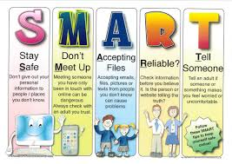
Digital Leaders Assembly

Slide 2
Digital Leaders
Responsibilities
Helping children around the school with technology.
Managing IT resources, e.g. labelling and returning resources.
Turn off technology when not in use.
Running clubs for other children in the computing suite.
Designing posters to raise awareness.
Training with Mr Robbins.
Share views on computing and how we can make it better as a school.
Lead assemblies.
You will also receive a badge!

Slide 3
Digital Leaders
How do I become one?
Your class teacher will select two children from each class.
You can write a supporting letter to let them know you would like to take part.
These letters will be available in your classes.
When will we find out?
Your class teacher will let you know on Friday.

Slide 4
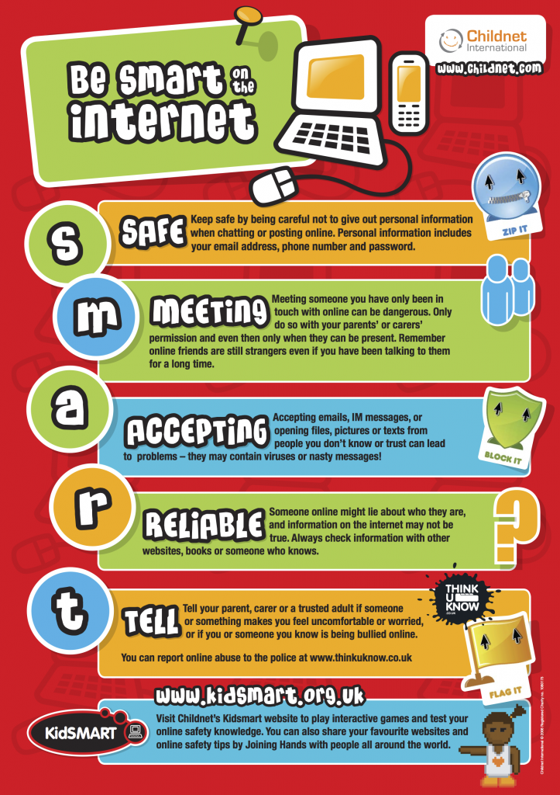
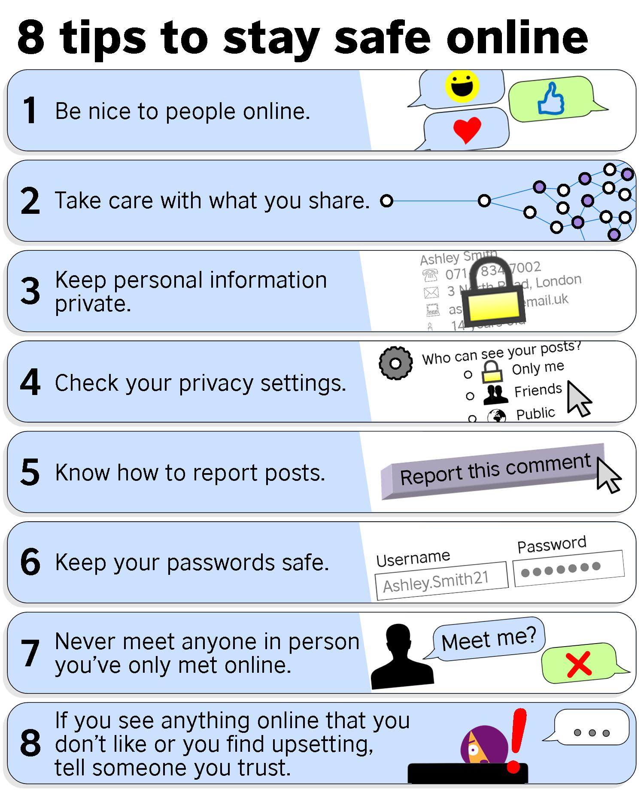
E-Safety
If you have any concerns about something that has happened on the internet please speak with an adult.

Slide 5
Be safe, be smart, be responsible.

