Slide 1
E-Safety Parent Forum Mr Robbins
Explain safeguarding regarding keeping children safe in education.
Share E-Safety tips and discuss computing curriculum.
Share feedback and concerns you have regarding your child and safety online, allowing us to take this back to class teachers to incorporate into lessons.

Slide 2
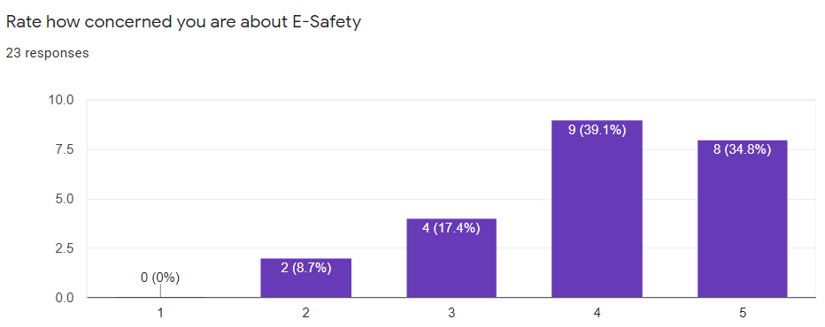
Why are we here?
Fire/evacuation procedures

Slide 3
At Stewart Fleming we endeavour to ensure every child is safe physically and virtually
Child abuse in all its forms is increasingly being linked to the use of technology. Technology is constantly being updated and the internet can now be accessed using mobile phones, laptops, computers, tablets, webcams, cameras and games consoles. Particularly as a result of successive lockdowns, children have increasingly become more comfortable online.
Keeping children safe in children has now been extended to include the prevention of cyberbullying.
How true do you think this is?
What devices does your child use?

Slide 4
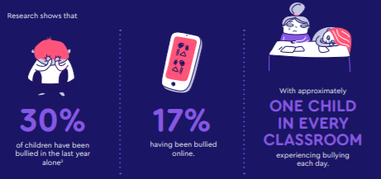
Risks to children
There are risks online from inappropriate content such as adverts, gambling, violence, inappropriate images, misleading information or advice, racism and hate speech.
Children and young people could be at risk online from people they actually know as well as strangers (who the child believes, over time, that they know).
How well do you know who your children speaks to online?

Slide 5
Advice and support is available:
Helpful organisations that offer insightful guidance:
Advice for parents and carers from Childnet
Tips, advice and guides for parents and carers from the UK Safer Internet Centre
Guides on popular apps and games from NetAware
Reviews and information about games, apps, TV shows and websites from Common Sense Media
Help on using parental controls and privacy settings from Internet Matters
Information and reporting of online grooming or abuse from CEOP
Your child’s teacher, myself or our Designated Safeguarding Lead.

Slide 6
E-Safety opinions
“Just take everything away, that will deal with the problem” – What do you think the strengths and weaknesses are of this approach?
“My child is addicted to their devices they NEED them, I can’t stop them” – What do you think about this?
“Monitoring online usage and what my child does allows me to have peace of mind” – Is this invasive?

Slide 7
Dealing with E-Safety should be dealt with as a joint approach between schools and parents
At the first instance, you should always discuss concerns you have regarding your child and their online safety with the class teacher.
This can be very helpful to build a wider picture about particular situations.
Incidents that happen online can quickly snowball into real life for young children.
What do you think the main issues is for your child online?

Slide 8
Have a conversation
It is really important to chat with your children on an ongoing basis about staying safe online.
Ask your children to tell you about the sites they like to visit and what they enjoy doing online.
What games do you and your friends like to play online? Can you show me the websites you visit the most? Shall we play your favourite game online together?
Ask them about how they stay safe online.
What tips do they have for you, and where did they learn them? What is OK and not OK to share?
Ask them if they know where to go for help.
Where can they go to find the safety advice, privacy settings and how to report or block on the services they use?
Think about how you each use the internet.
What more could you do to use the internet together? Are there activities that you could enjoy as a family?

Slide 9
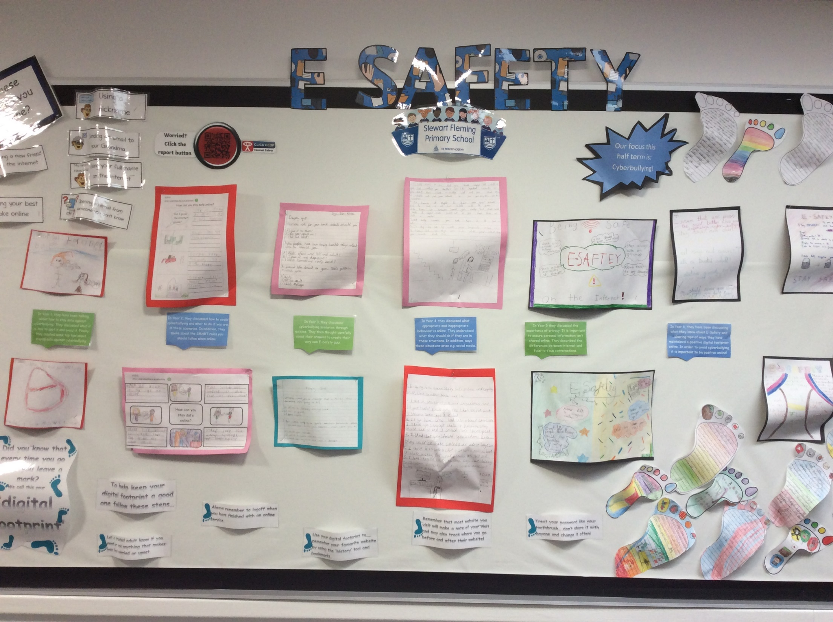
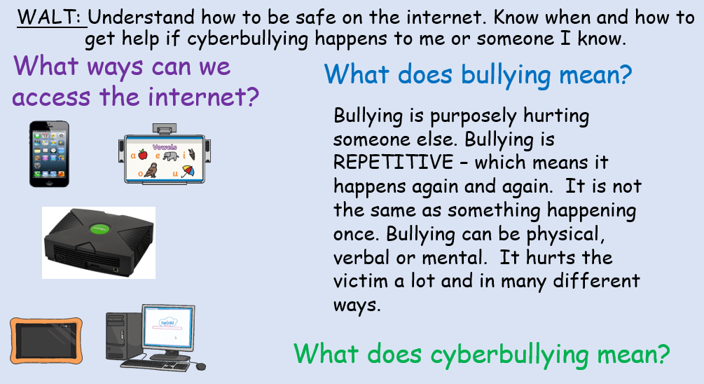
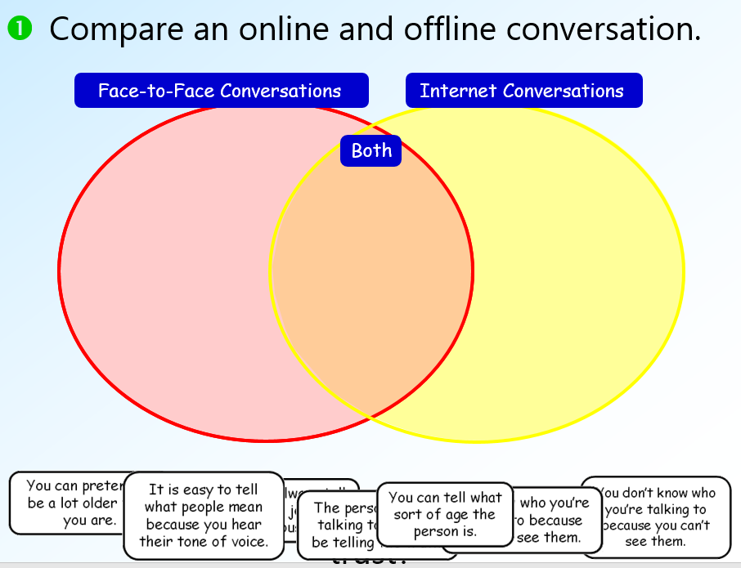
Our commitment
At Stewart Fleming, each class teaches an E-Safety lesson at the start of every half term.
We also ensure that E-Safety is regularly mentioned throughout the computing topics, leaving these fresh in memory.
Parent forum to discuss E-Safety issues.
Safer Internet Day is a global campaign to promote the safe and responsible use of technology, which calls on young people, parents, carers, teachers, social workers, law enforcement, companies, policymakers, and more to join together in helping to create a better internet.
Cyberbullying focus during Anti-Bullying week.
E-Safety computing display
Example from Y2
Example from Y5

Slide 10
Feedback
Please complete the feedback sheets to share any opinions, concerns and comments you have regarding anything we have discussed today.

