Slide 5
https://www.ofcom.org.uk/__data/assets/pdf_file/0024/234609/childrens-media-use-and-attitudes-report-2022.pdf

Slide 6
https://www.ofcom.org.uk/__data/assets/pdf_file/0024/234609/childrens-media-use-and-attitudes-report-2022.pdf

Slide 13
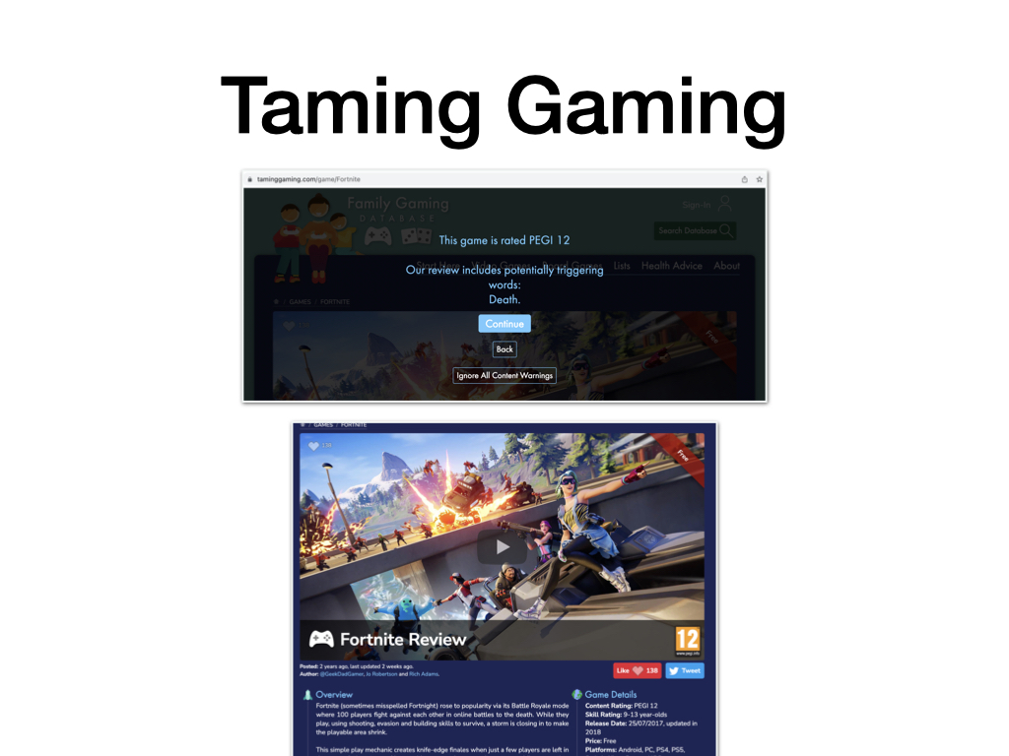

Slide 15
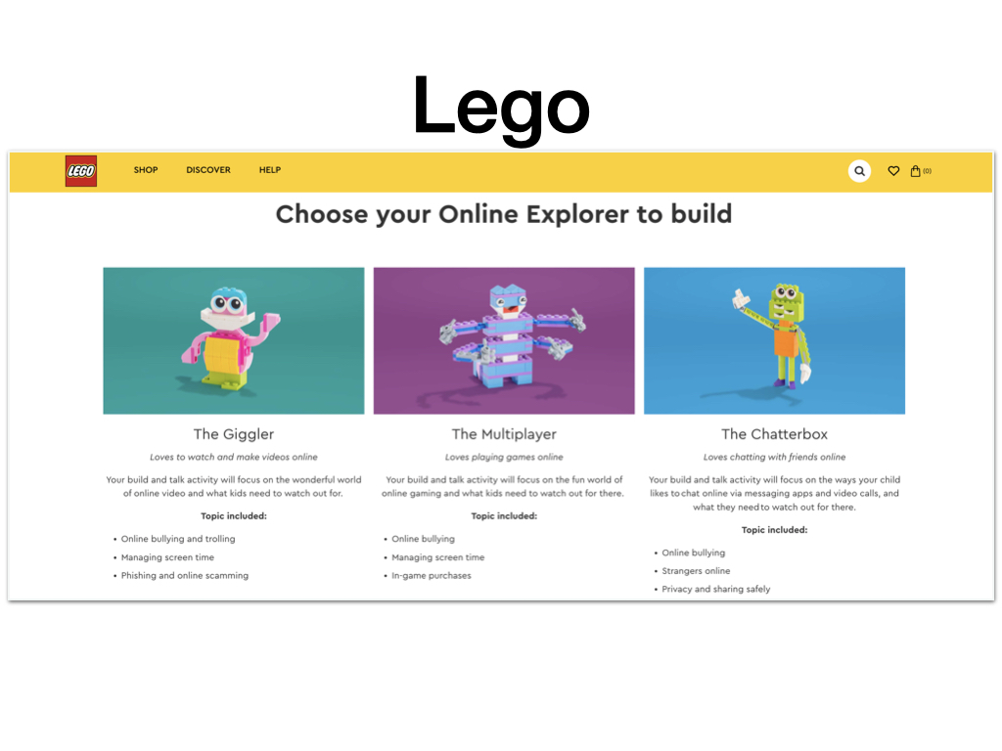

Slide 17
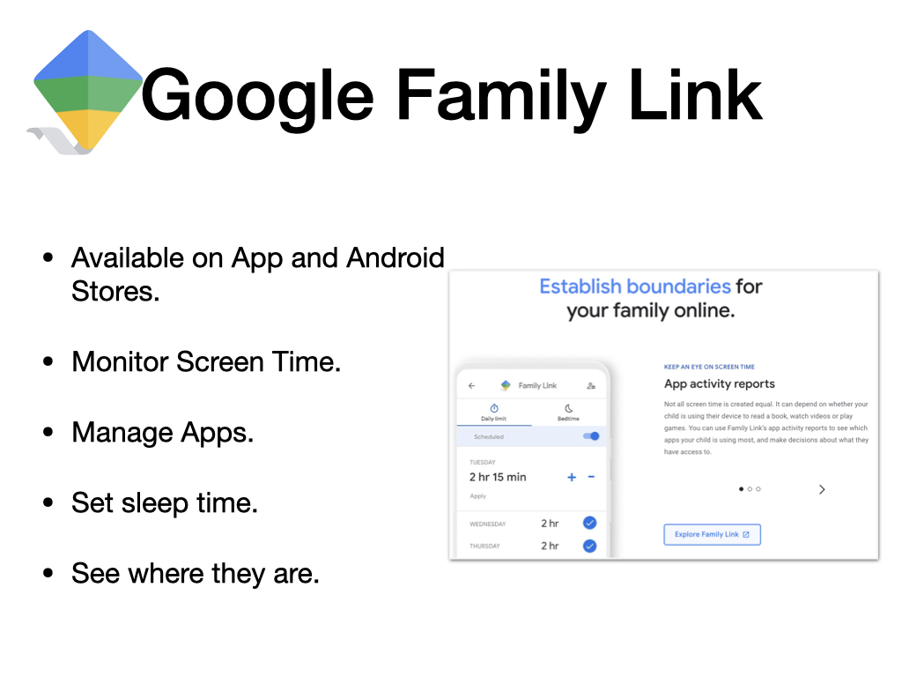

Slide 19
Support for you
You can alway speak to:
CEOP
NSPCC
School
Or for more general information you can visit these sites:
UK Safer Internet Centre (https://www.saferinternet.org.uk/)
Internet Matters (https://www.internetmatters.org/)
The Parent Zone (https://parentzone.org.uk/home)

