Slide 1

Teach reading: change lives
Parent & Carer Workshop: Phonics and early reading

Slide 2

Year 1
Phonics Screening Check

Slide 3
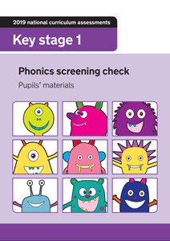
What is the Phonics Screening Check?
The phonics screening check is a statutory reading check that all year 1 children take during a particular week in June.
The check is designed to assess if each child has reached the age appropriate standard of decoding by the end of year 1.

Slide 4
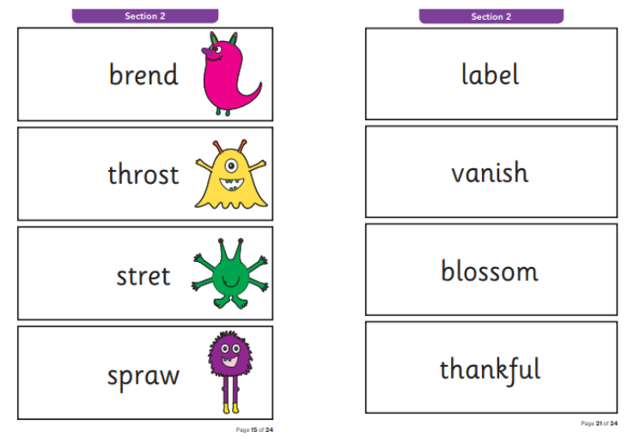
What happens during the check?
The check is completed by the child on a 1:1 basis with a teacher. It usually takes 5-10 minutes for the child to complete.
The check contains 40 words - 20 real and 20 pseudo words (nonsense words). The words are presented to the child in the form of a booklet with 4 large words per page.
The words gradually get more difficult from 2 and 3 ‘sound’ words such as ‘it’ and ‘vap’, to longer words with more complex graphemes, such as ‘thankful’.
Notes:
After the first sentence- Explain after first sentence- There is no time limit and the child can take as long as they need. The teacher can also allow the child a rest break if it is necessary.
After the second sentence-Explain- here are examples of how the words are presented to the children: The pseudo words are presented with a picture of an alien. This tells the child that this word will not make sense to them. It will instead be the name of the kind of alien. This has been added so that the child does not attempt to turn the words into real words.
Finally- Reassure parents- Please don’t worry, your child will have worked on similar activities in their phonics lessons and will be familiar with the format. The only difference will be that the teacher will be unable to help the children on this occasion.

Slide 5
Why use ‘pseudo’ (nonsense) words?
The ultimate aim of teaching phonics is that the child progresses from decoding each sound, to automatic recognition of words. However, even as adults, we still need to be able to decode unfamiliar words.
The ability to decode unfamiliar words will help your child to read increasingly more difficult texts and will help them to develop their vocabulary.
The pseudo words allow the teacher to be sure that the child is able to decode unfamiliar words and is not just reading words from memory.

Slide 6
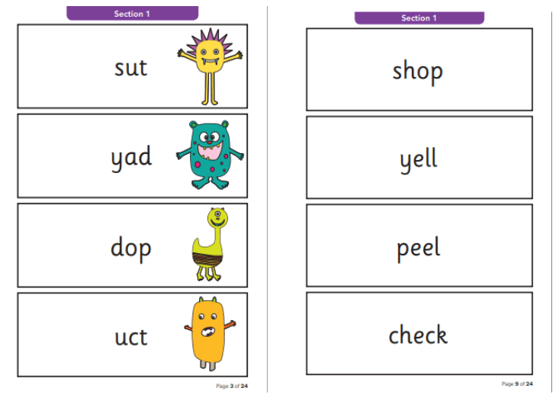
What is the pass mark?
For the last few years, the expected standard for the screening check has been set at 32 out of 40 words correctly decoded.
However, this can change and the Department for Education does not release the ‘pass’ mark until a few weeks after the children have completed the check.

Slide 7
Do all children complete the check?
It is expected that all year 1 children complete the screening check, unless they have no understanding of grapheme-phoneme correspondence (the way sounds link to letters).
There is no time limit on the check and the teachers are able to edit the size of the text or the number of words presented to the child at once, if this is necessary.
Notes:
After sentence 1- explain- However, if a teacher feels a child is really struggling, they may choose to end the check before the end.

Slide 8
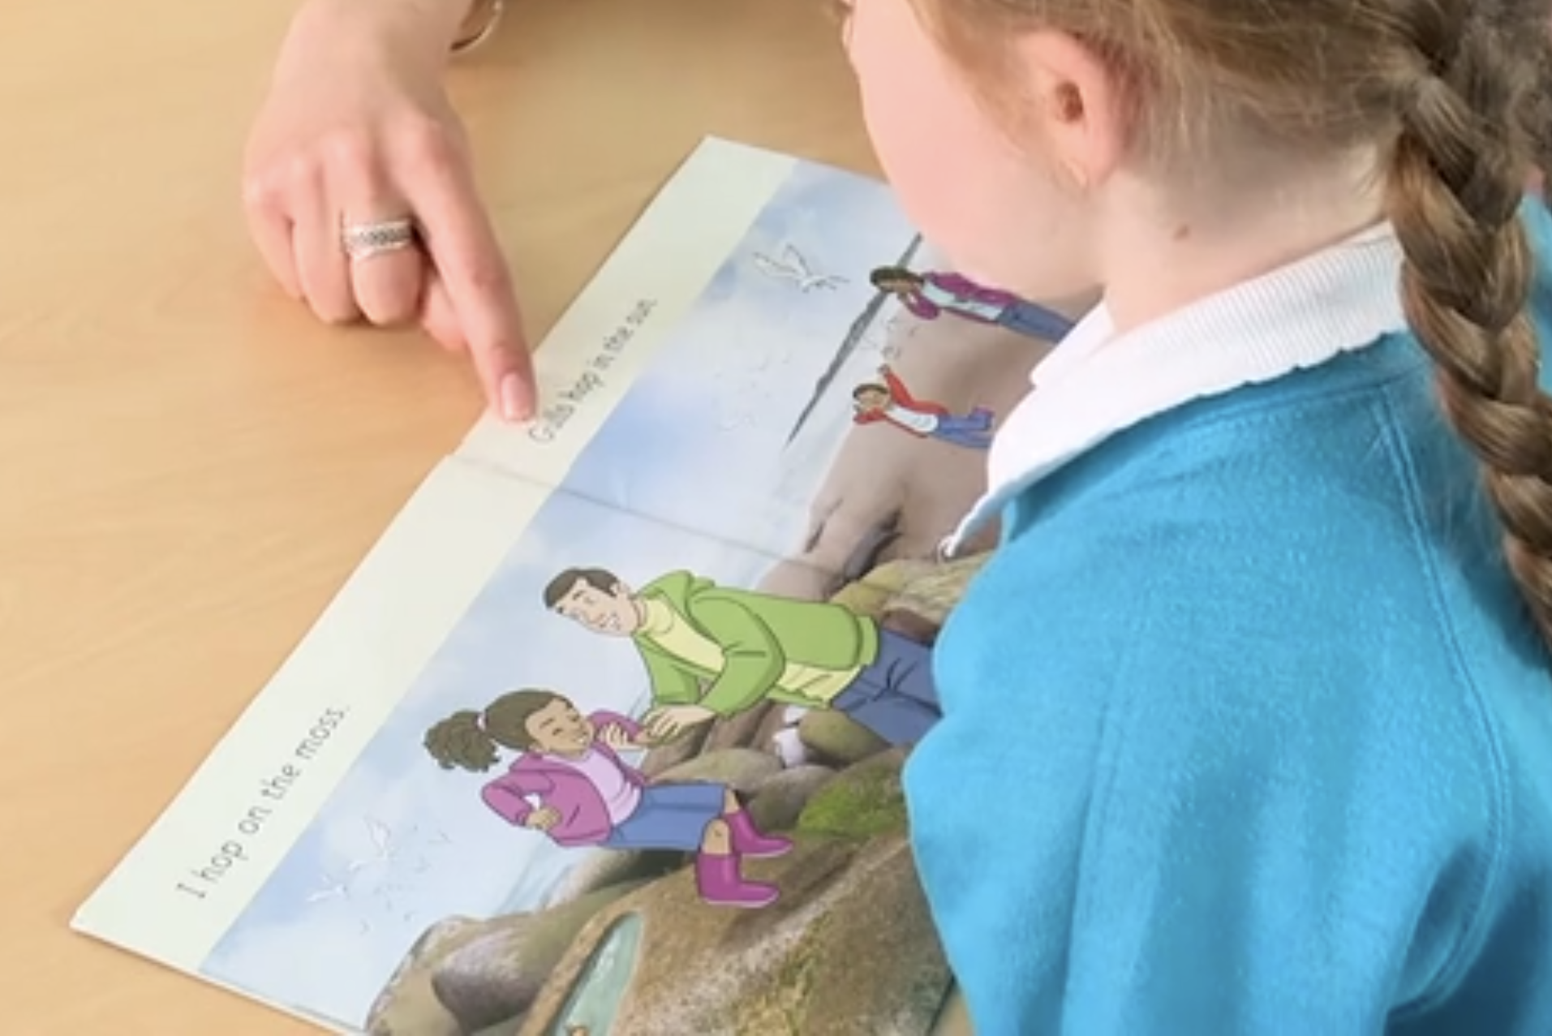
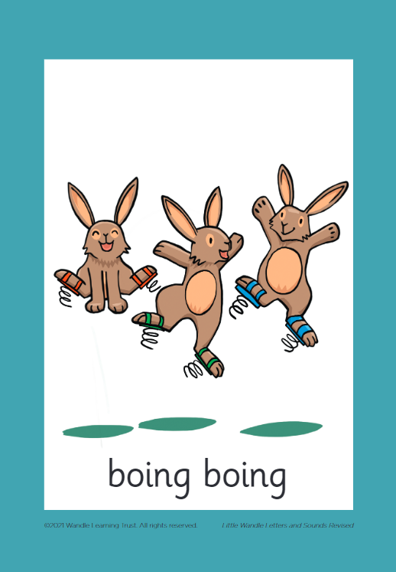


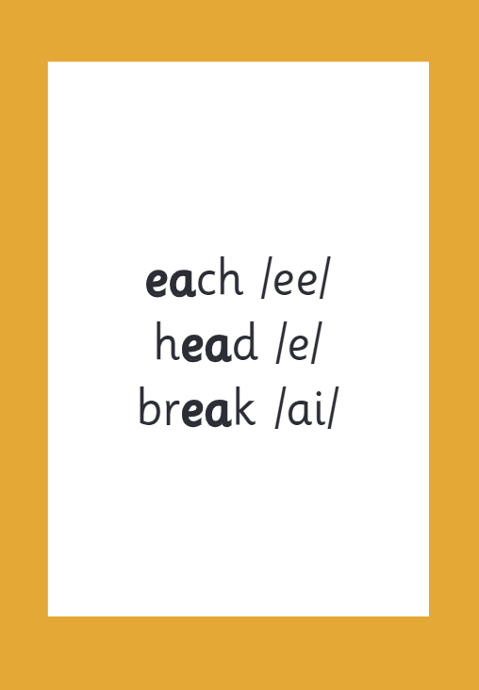
What happens if my child does not meet the expected standard?
If a child does not meet the expected standard, the school are required to provide extra support for them in phonics.
Children who do not meet the expected standard in year 1, complete the check again in year 2.

Slide 9

What happens to the data?
You will be informed of your child’s result shortly after the check is completed.
The data collected from the check is used within school to provide assessment on the child’s decoding skills.
Data is submitted to the Local Authority and used by the Department for Education to publish statistics at local and national level.
Please ask your child’s teacher for any further information, they will be happy to help!
Notes:
Provide an opportunity for parents/carers to ask questions at this point…
Reminding them that if they do have questions following this, they can also ask their child’s teacher.

Slide 10
Supporting your child at home

Slide 11

The most important thing you can do is read with your child
Reading a book and chatting had a positive impact a year later on children’s ability to…
understand words and sentences
use a wide range of vocabulary
develop listening comprehension skills.
The amount of books children were exposed to by age 6 was a positive predictor of their reading ability two years later.
Parental involvement in the development of children’s reading skills: A five-year longitudinal study (2002) Senechal, M. and Lefvre, J
Notes:
Celebrate child’s success at school, make time for reading at home!

Slide 12
Listening to your child read their phonics book
Your child should be able to read their book without your help.
If they can’t read a word read it to them.
Talk about the book and celebrate their success.

Slide 13

Read to your child
The shared book is for YOU to read:
Make the story sound as exciting as you can by changing your voice.
Talk with your child as much as you can:
  Introduce new and exciting language
  Encourage your child to use new vocabulary
  Make up sentences together
  Find different words to use
  Describe things you see.

Slide 14

Books going home
Notes:
As well as the ‘learning to read’ book that your child will bring home they will also bring home a book for sharing with you. This book is SO important. This is how we are going to give them the WILL to read. Please read with your child as often as you can – at least once a day if possible.

Slide 15
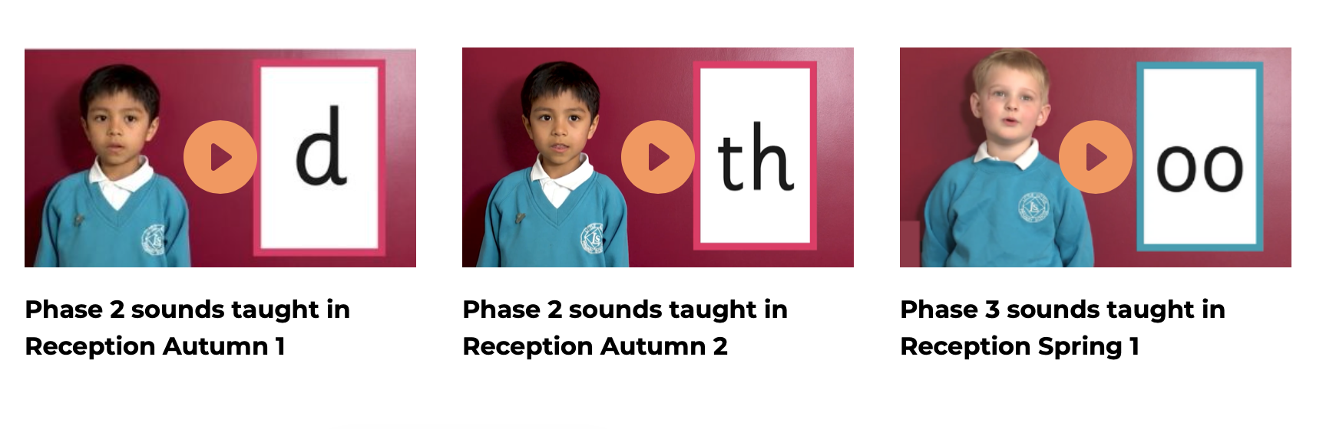
Supporting your child with phonics
Notes:
It is really important that you pronounce the sounds correctly at home if you are supporting your child. These videos are on the website for you to refer to and if you are unsure, please ask your child’s teacher.
Show the parents where to access the videos on the website and play them!
https://www.littlewandlelettersandsounds.org.uk/resources/for-parents/

Slide 16
Resources being sent home
We will be providing each class with 30 packs of resources to support your children at home. The packs will include the following
Grapheme matts
Tricky word support
Support on how to say the sounds
Please speak to your child's teacher at the beginning of next week to receive your pack of resources.
Parental involvement in the development of children’s reading skills: A five-year longitudinal study (2002) Senechal, M. and Lefvre, J
Notes:
Celebrate child’s success at school, make time for reading at home!

Slide 17
One of the greatest gifts adults can give is to read to children
Carl Sagan

