Slide 1


Good Morning!
Welcome to Year 1 Curriculum Meeting

Slide 2
Year 1 Team
Class teachers
Esther Underwood Ellis Davey Joel Stephenson Nathan Carnegie
Support Staff
Sam Selman Donna Bousbia Katy Leggett
Specialist Teachers
Jordan Williams – PE
Vanessa Howe – Art / DT
Angharad Edmunds – Music

Slide 3
School Vision
Every day at Stewart Fleming is an extraordinary school day. Our unwavering commitment in delivering an inspiring and inclusive curriculum develops independent learners. We endeavour to nurture inquisitive minds to enable them to become the best that they can be.

Slide 4
Soft Start Morning 8:45 – 9:00
At Stewart Fleming we believe that in order to expect positive and respectful communication, we need to model and provide opportunities for it within our school day. Therefore we encourage all children to come to for at 8:45 am start.
Once they come into their room there will be music playing, books to read, partner games to play and optional curriculum or PSHE tasks to do.
The tasks cover aspects of our SMSC (spiritual, moral, social and cultural development) calendar such as Road Safety Week, Anti-Bullying Week and Children in Need.
Teachers and support staff in the room play a crucial role. They engage with children, support children's excitement of learning for the day and tutor. This morning routine is fundamental to driving Stewart Flemings ethos as it develops independence, positive communication and well-being of every child.

Slide 5
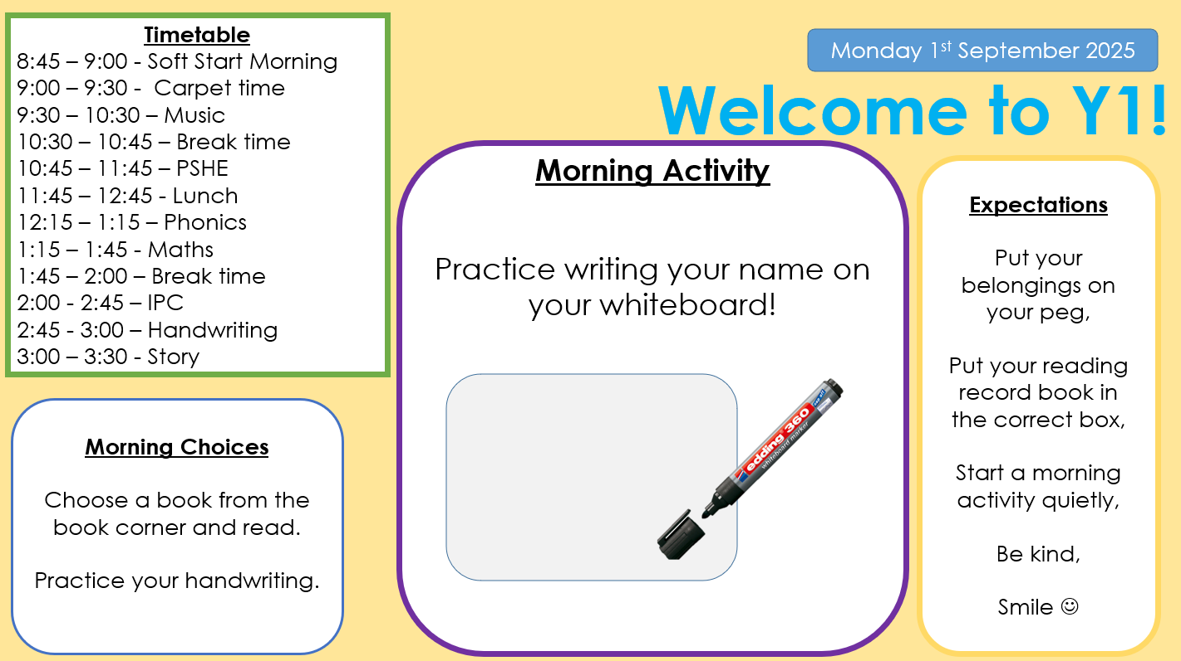

Slide 6

Curriculum Offer at Stewart Fleming
Subject | Curriculum Scheme
English (Reading) | Little Wandle (EYFS – Y2) CUSP (Y1-Y6)
English (Writing) | CUSP
Maths | White Rose Maths
Science, History, Geography, DT and Art | IPC
French | Language Angels
Computing | IPC
PE | PE PRO
RE | Bexley Scheme
PSHE | IPC
Handwriting | Penpals

Slide 7
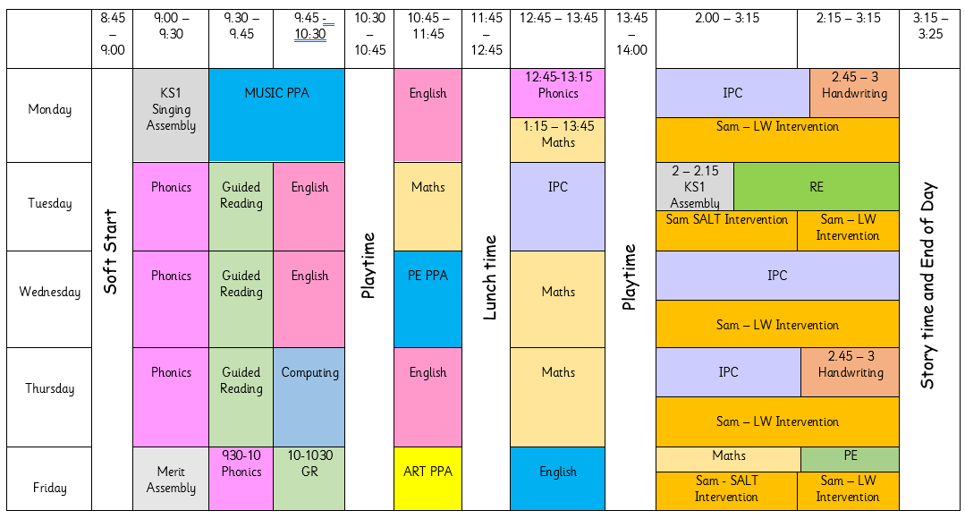
Timetable

Slide 8


English
In English we will be reading the books Beegu by Alexis Deacon and Where The Wild Things Are by Maurice Sendak.
In writing:
The children focus on how to form sentences correctly (finger spaces, capital letters, full stops, editing). The children will learn how to write setting description and they will explore poetry through rhyme and pattern.
In reading:
The children will learn how to make predictions, how to retrieve facts from sentences and how to recall the main points from a story.

Slide 9
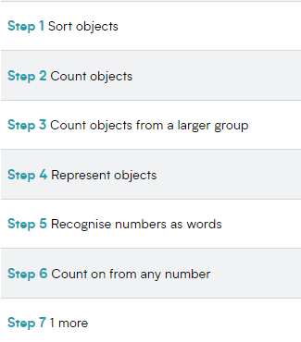
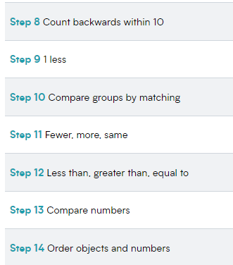
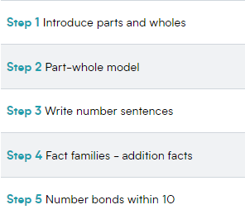
Maths
Place Value
Addition and Subtraction

Slide 10
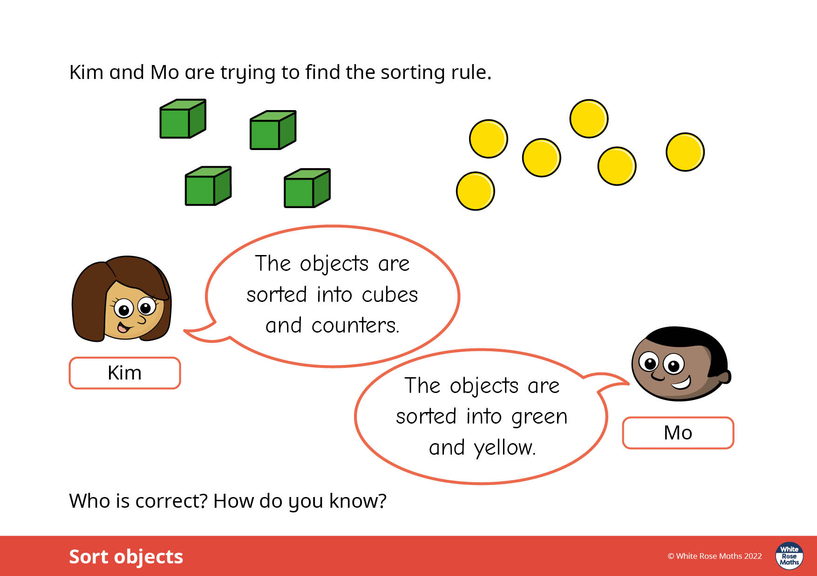
Maths
Everyday the children are exposed
to reasoning and problem solving.

Slide 11
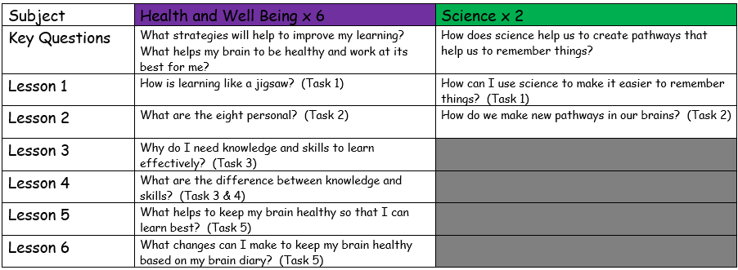
IPC Topic: Brainwave and Learning Safely Online
This topic covers Health and Well-being, Science and ICT.

Slide 12
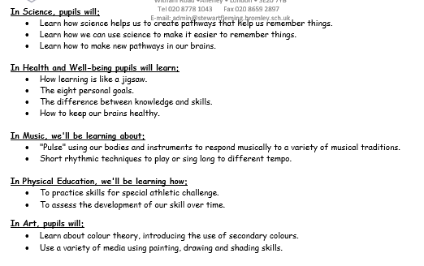
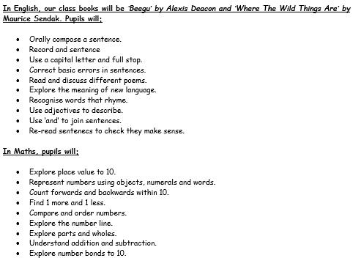
Curriculum Letter

Slide 13
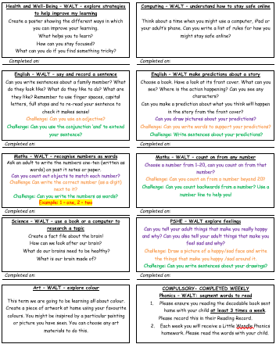
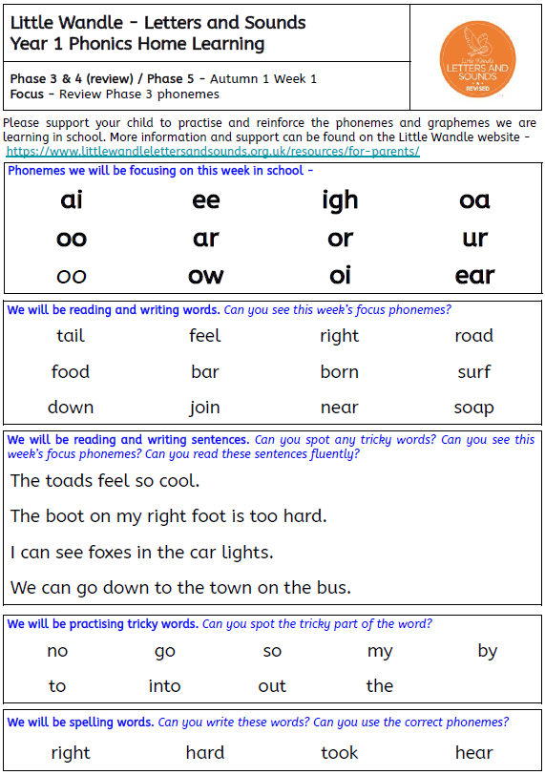
Homework
Homework will be sent out on Fridays and needs to be handed in the following Wednesday.
Reading books will be changed every Monday and Thursday. Your child will receive a Little Wandle decodable book and a book for pleasure.
Little Wandle sheet will be sent out weekly.

Slide 14
Parental Engagement
Thursday 25th September - Year 1 Team building workshop
Monday 29th September - Year 1 Reading Morning
Tuesday 14th and Wednesday 15th October – Parents Evenings

Slide 15
Questions?

