Slide 1


Good Morning!
Welcome to Year 2 Curriculum Meeting

Slide 2
Year 2 Team
Class teachers
Hawkings class: Miss Powell and Mrs Searle
Seacole class: Miss John and Miss Butlin
Brunel class: Miss Leung and Mrs Gobbi
Specialist Teachers
Jordan Williams – PE
Vanessa Howe – Art / DT
Angharad Edmunds –Music

Slide 3
School Vision
Every Day at Stewart Fleming is an extraordinary school day. Our unwavering commitment in delivering an inspiring and inclusive curriculum develops independent learners. We endeavour to nurture inquisitive minds to enable them to become the best that they can be.

Slide 4
Soft Start Morning 8:45 – 9:00
At Stewart Fleming we believe that in order to expect positive and respectful communication, we need to model and provide opportunities for it within our school day. Therefore we encourage all children to come to for at 8:45 am start.
Once they come into their room there will be music playing, books to read, handwriting practise and optional curriculum or PSHE tasks to do.
The tasks cover aspects of our SMSC (spiritual, moral, social and cultural development) calendar such as Road Safety Week, Anti-Bullying Week and Children in Need.
Teachers and support staff in the room play a crucial role. They engage with children, support children's excitement of learning for the day and tutor. This morning routine is fundamental to driving Stewart Flemings ethos as it develops independence, positive communication and well-being of every child

Slide 5
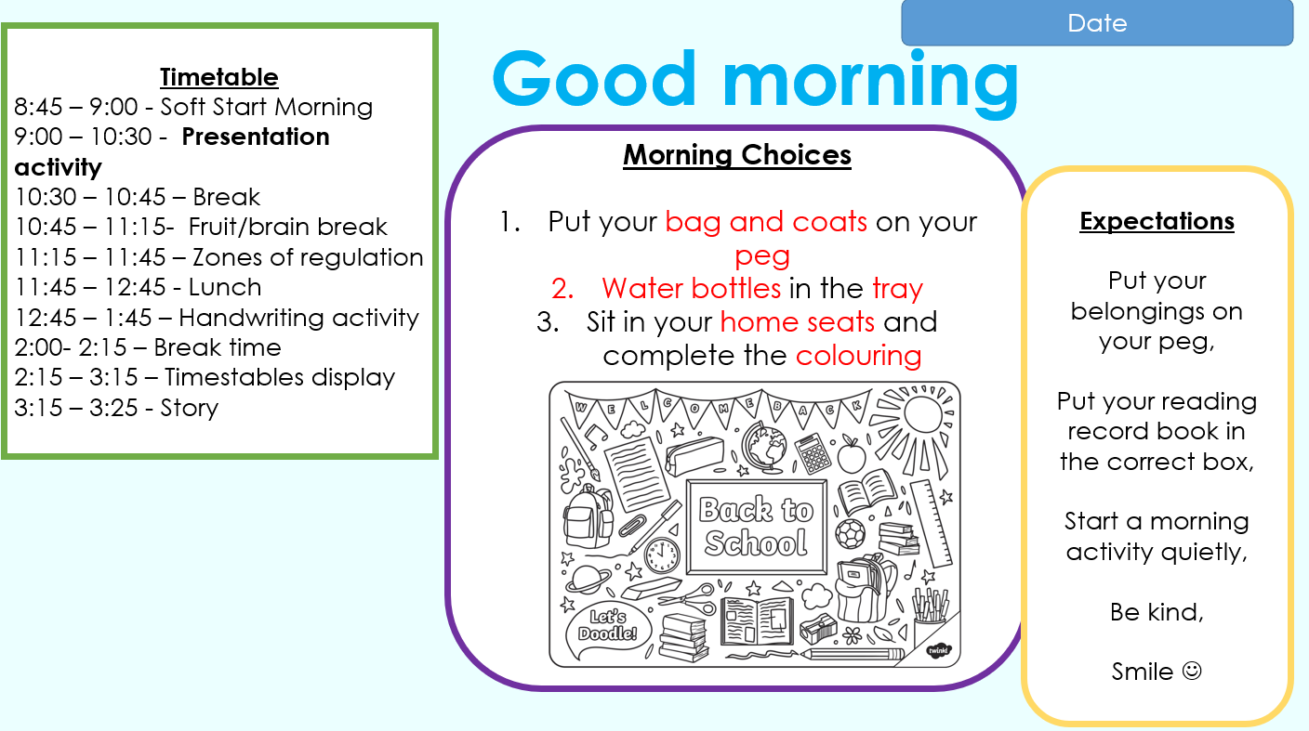

Slide 6

Curriculum Offer at Stewart Fleming
Subject | Curriculum Scheme
English (Reading) | Little Wandle (EYFS – Y2) Reading - CUSP
English (Writing) | CUSP
Maths | White Rose Maths
Science, History, Geography, DT and Art | IPC
French | n/a
Computing | IPC
PE | PE PRO
RE | Bexley Scheme
PSHE | IPC and CWP

Slide 7

Timetable
The timetable for all classes will be uploaded onto the website shortly.
PE days:
Seacole: Wednesday and Thursday
Hawking: Wednesday and Thursday
Brunel: Tuesday and Friday
Children are expected to wear their PE kit to school on the above days.

Slide 8





English
Our English curriculum (CUSP) covers reading, writing and spelling. We will have 5 CUSP lessons a week, some of these will be reading and some will be writing (normally 3/2 then swap round the following week). In the afternoons, we will have dedicated lessons for spelling and handwriting.
Over the course of the Autumn term, we will be reading a variety of text and exploring the different themes in the books. We will then be using these texts as inspiration for our writing.
In our writing lessons, we will be exploring a variety of style, format and skills.
We will start our writing lessons by examining and recapping the basics of writing a sentence (word order and punctuation), before writing our creative pieces.

Slide 9
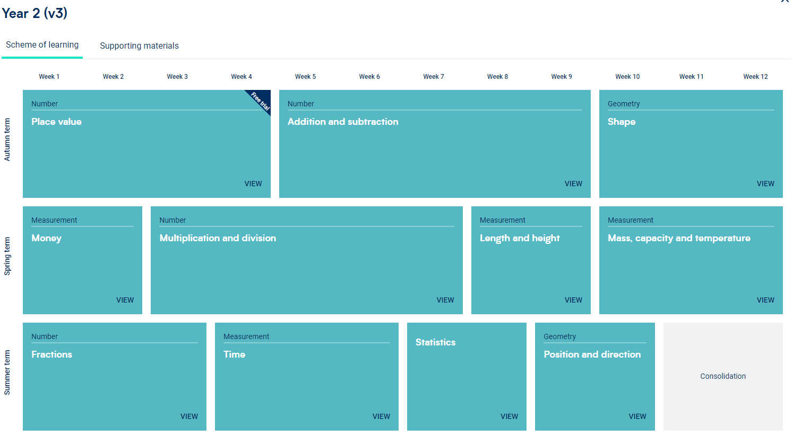
Maths
In place value we will be looking at:
Partitioning numbers
Using pace value charts
Writing numbers as words
In addition and subtraction we will look at:
Adding and subtracting one and two digit numbers away from each other
Using symbols to compare numbers
Missing number word problems
During shapes we will look at:
The differences between 2D and 3D shapes
Looking at and counting key features of shapes
Using lines of symmetry
This term we will be looking at place value, shapes, addition and subtraction.

Slide 10
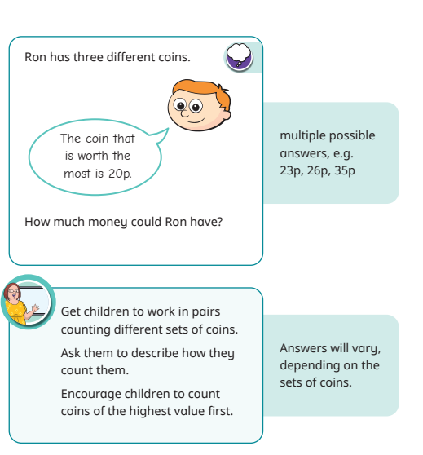
Maths
Every lesson, children are exposed to reasoning and problem solving.
These challenge questions are designed to make the children explain their reasoning, often requiring them to explain how they got to their answer.
These questions often have multiple answers which really develops the children’s thinking skills.

Slide 11
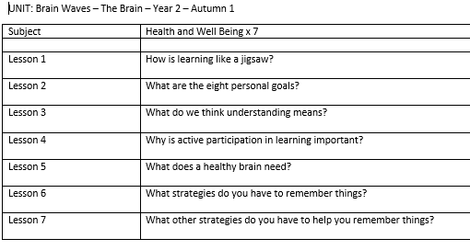
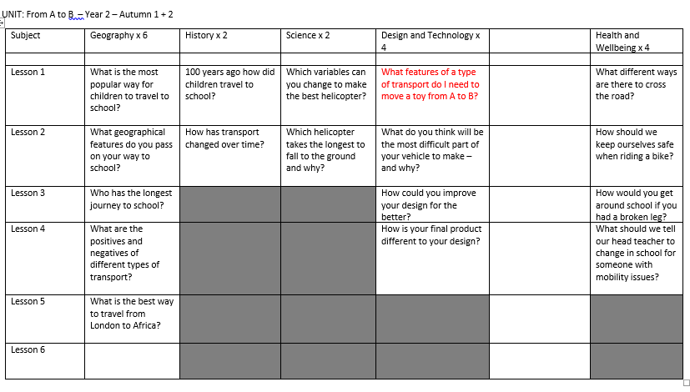
IPC Topics: Brainwave and From A to B
These topics cover a range of Geography, History, PSHE and Science lessons for this half term. Children will also take part in Art and DT lessons delivered by the Art teacher and class teachers.

Slide 12
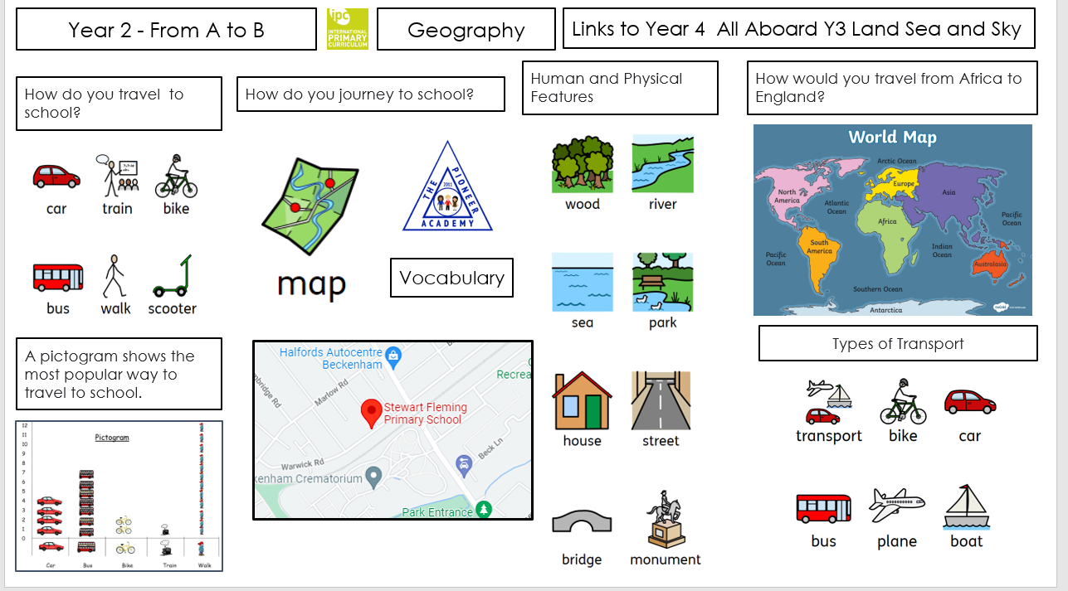

Slide 13
Curriculum Letter
In English, we will be:
Using capital letters and full stops in correctly structured sentences.
Using character descriptions
Developing our understanding of vocabulary in poems
Creating a simple retelling of a narrative
Writing formal invitations
Exploring stories from other cultures
In Maths, we will be:
Exploring our knowledge of place value
Using place value charts
Partitioning numbers to 100 using our knowledge of place value
Ordering and counting numbers to 100
In History, we will be finding out:
What journeys were like in the past by interviewing an elderly member of the community
Interviews and eyewitness accounts as a primary historical source
Timelines that show when different types of transport were invented
In Geography, we’ll be finding out:
How we travel to school
How we can use maps to record our journey
Travel to – and around – different countries
In PSHE, we’ll be learning about:
The brain
Metacognition and how it helps us learn
Thinking deeply when we read
Using prior knowledge
Philosophical thinking
Different types of questions
How emotions impact on learning
How different people learn
In P.E, we’ll be:
Exploring how to change our stride length
Learning how to pace ourselves when running long distance
Practising how to throw and catch in different stances
Developing our football, netball and dodgeball skills

Slide 14
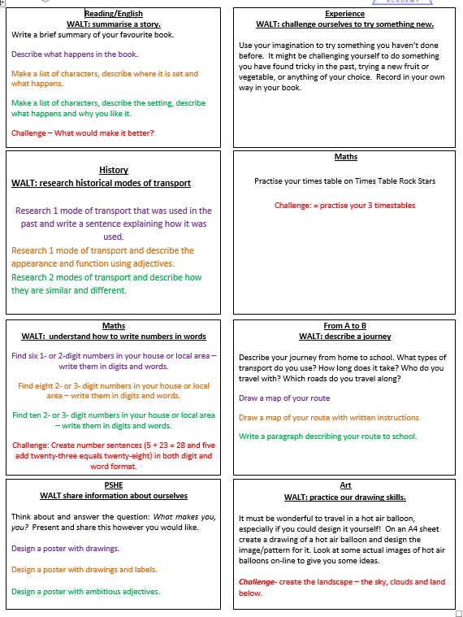
Homework
Homework will be sent home on a Friday and is due back the following Wednesday.
Spellings have changed this year; the children will have a separate spelling book which will go home on certain weeks, which are stated on the homework menu In these books, tasks will be stuck in for the children to complete. The words that feature in the work will be words and rules that we have been learning in class. There are no longer spelling tests every week. Spellings are in addition to the homework.
Children should be reading at home daily and recording this at least 3 times per week in their reading records. These need to come into school everyday.

Slide 15
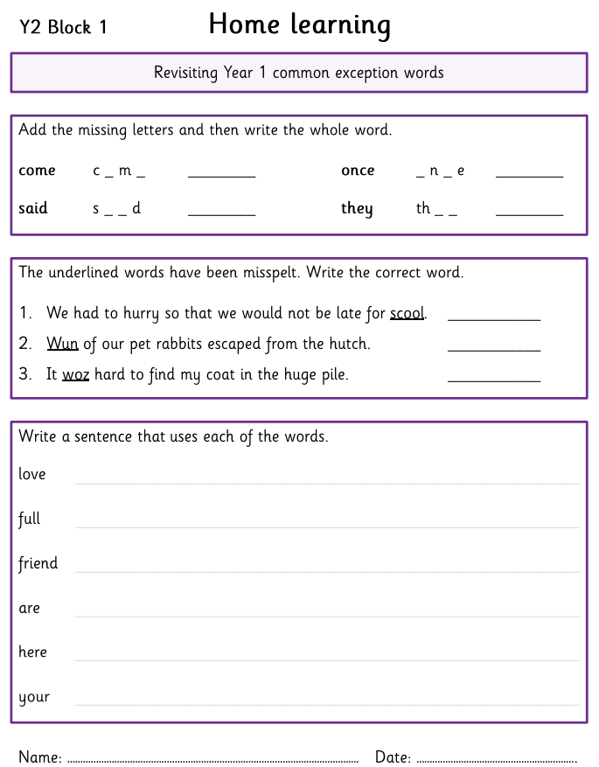
Spelling homework
In addition to the homework menu, a piece of spelling homework will also be handed out every Friday and expected to be completed and returned the following Wednesday.
This will be stuck in their homework book. An example has been attached for you to have a look at.

Slide 16
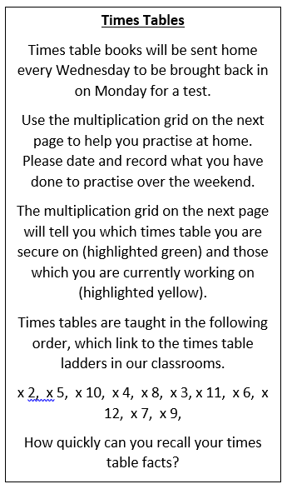
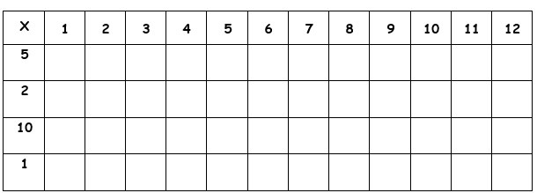
Timestables homework
Every Wednesday, the children will be taking home a small blue book that will have a timestables grid inside for the children to practise at home.
The following Monday, the children will be have a short timestables test and the beginning of their maths lesson.

Slide 17
Parental Engagement
Tuesday 9th September – French Day
Wednesday 1st October – Year 2 reading morning
Wednesday 8th October- Individual/sibling photos
Tuesday 14th and Wednesday 15th October – Parents evening

Slide 18

Questions?

