Slide 1


Good Morning!
Welcome to Year 5 Curriculum Meeting

Slide 2
Year 5 Team
Class teachers: Mr Leggatt(Wright), Miss Simmons(Hepworth) & Miss Tappenden(Mercury)
Mr Giles Dutton & Mrs Nike Babatunde are also part of the Year 5 team
Specialist Teachers
Jordan Williams– PE
Vanessa Howe – Art / DT
Angharad Edmunds –Music
Darrell Robbins- Computing

Slide 3
Streaming
This was communicated last academic year.
The children are going to be streamed in English & Maths.
Your child will always be taught by one of the Year 5 teachers.
The groups are flexible and designed to best support your child’s learning

Slide 4
Phones at Stewart Fleming
At Stewart Fleming, phones are not to be used on the premises.
Children in Year 5 and 6 are permitted to bring phones to school with them if they travel to and from school alone, however these should not be used on the premises.
When they arrive at their class, their phones must go straight into the class locker which the class teacher will lock for the duration of the day.
At the end of the day, the teacher will unlock this and the children will get their phones back.
These must go straight into their bags and should not leave them until they leave the school gates!
Please remind your children about the importance of being vigilant when walking to and from school and not using their phones when crossing roads etc.

Slide 5
Social media
In the past, we have had incidents of social media use outside of school hours impacting children’s wellbeing in school.
WhatsApp is a chat application which can be used on a mobile phone or tablet, it lets you send messages, images and videos to friends. You can have one to one and group conversations. This letter is to make you aware that your child may be using WhatsApp without your knowledge and you should be mindful that the minimum age for WhatsApp is 16 or over. For more information about WhatsApp please visit: https://www.nspcc.org.uk/keeping-children-safe/online-safety/online-safety-blog/2023-01-12-is-whatsapp-safe-for-my-child/
As a school we strongly advise you to remove WhatsApp from your child’s phone and ensure any messaging between children is regularly monitored. In line with our behaviour policy, sanctions can be enforced in school, when children are being targeted through the medium of WhatsApp groups.

Slide 6
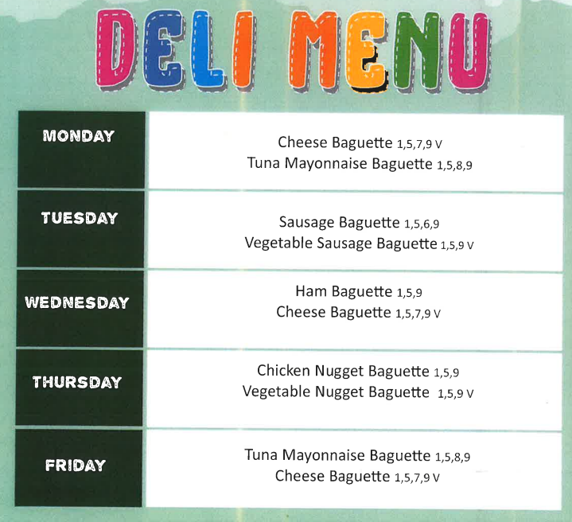

Slide 7

Curriculum Offer at Stewart Fleming
Subject | Curriculum Scheme
English (Reading) | Little Wandle (EYFS – Y2) Whole class Guided Reading using CUSP
English (Writing) | CUSP
Maths | White Rose Maths
Science, History, Geography, DT and Art | IPC
French | Language Angels
Computing | IPC
PE | PE PRO
RE | Bexley Scheme
PSHE | IPC and CWP

Slide 8
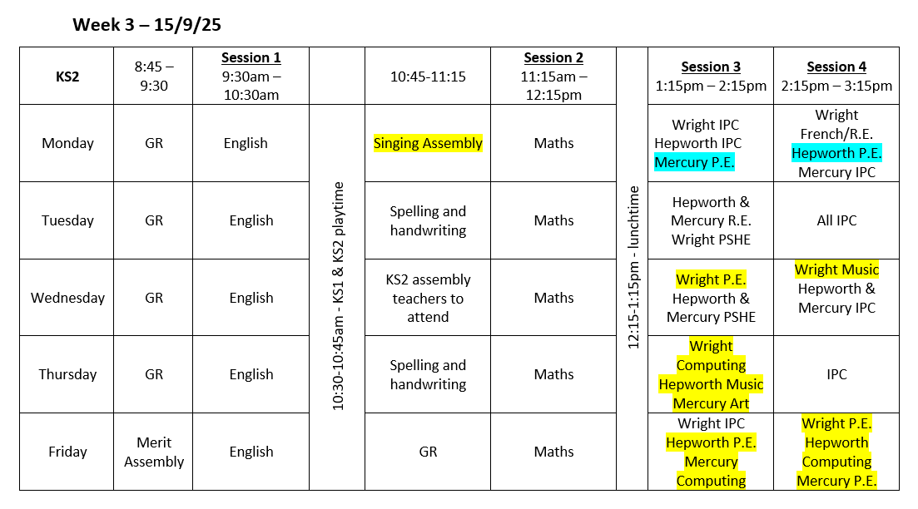
Timetables

Slide 9

English
This half term, Year 5 will be studying the book ‘Shackleton’s Journey’ which explores Ernest Shackleton’s expedition crossing the Antarctic.
Within our new scheme children will explore a range of different writing skills.
Each skills has ‘ingredients for success’ which the children can consistently review. They will read model texts which demonstrate these skills and support them to use them in their own writing.
This term children will be exploring:
Using third person to write stories set in different cultures
Formal letters of application
Poems that use wordplay

Slide 10


English
Next half term, Year 5 will be studying the book ‘Secrets of a Sun King’ which follows a journey to deliver a package to Egypt.
Within English lessons, children will be exploring:
Dialogue in narrative and use of appropriate punctuation
Poems which explore form
Balanced arguments

Slide 11
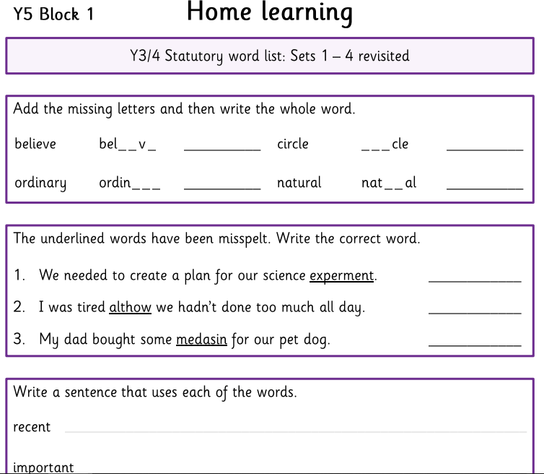
Reading and spellings
Children are still expected to read and comment 3x per week.
Comments should be written by the child or adult and focus on things that they have enjoyed, struggled with, summaries and predictions. We love to see a range of texts being explored.
Spellings will now be weekly and tasks will be stuck into homework books. See example.
When completing spellings homework, we do encourage children to use a physical dictionary if they are unsure how to spell a word. If they don’t have access to a dictionary, online dictionaries can also be used to support them.

Slide 12
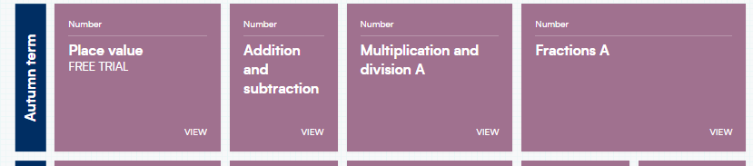
Maths
https://whiteroseeducation.com/parent-pupil-resources/maths/home-learning?year=year-5-new

Slide 13
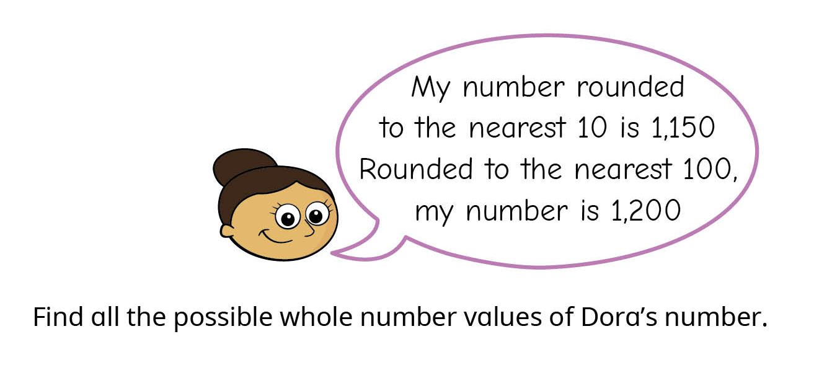
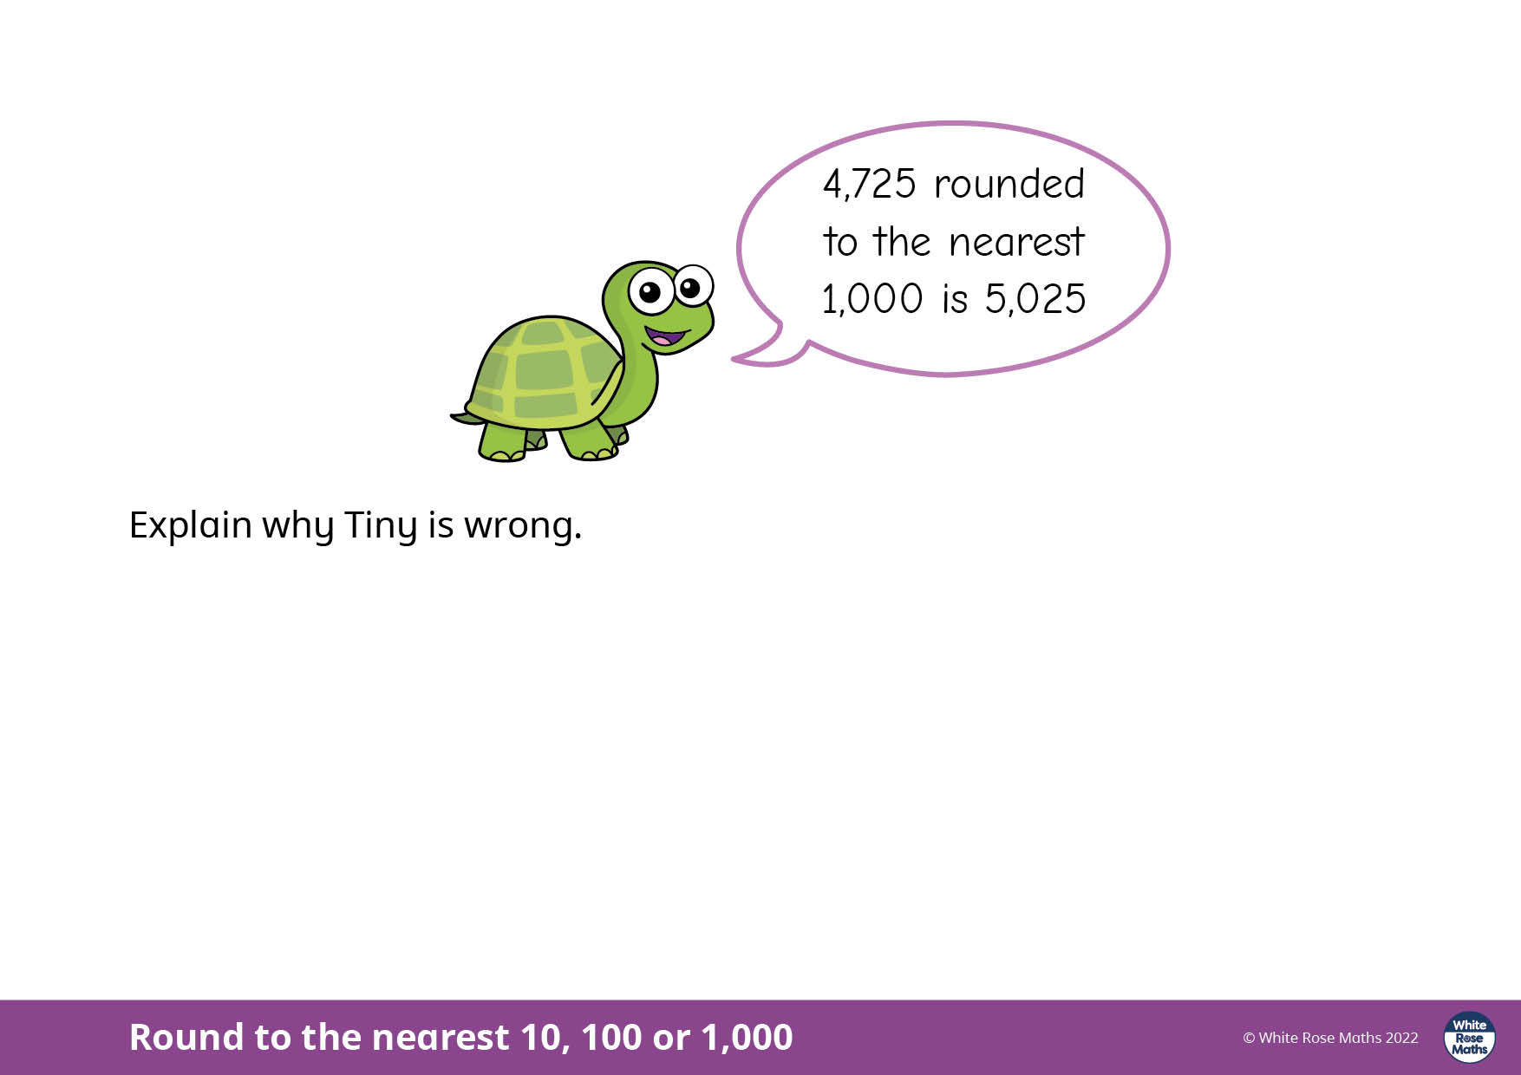
Maths
Every lesson, children are exposed to reasoning and problem solving.

Slide 14
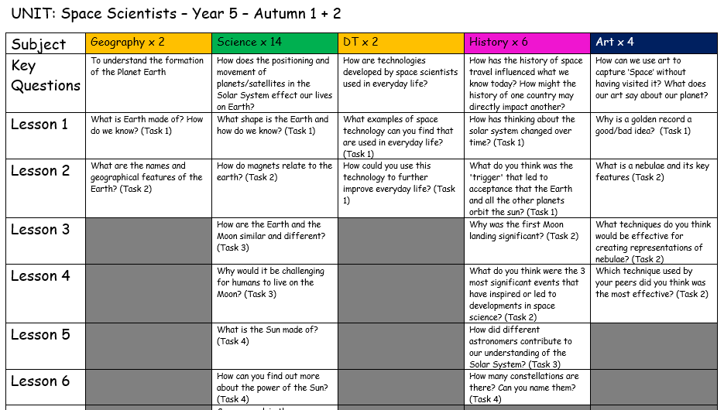
IPC Topic: Space Scientists
This topic covers a range of subjects such as Geography, Science, DT, History and Art.

Slide 15
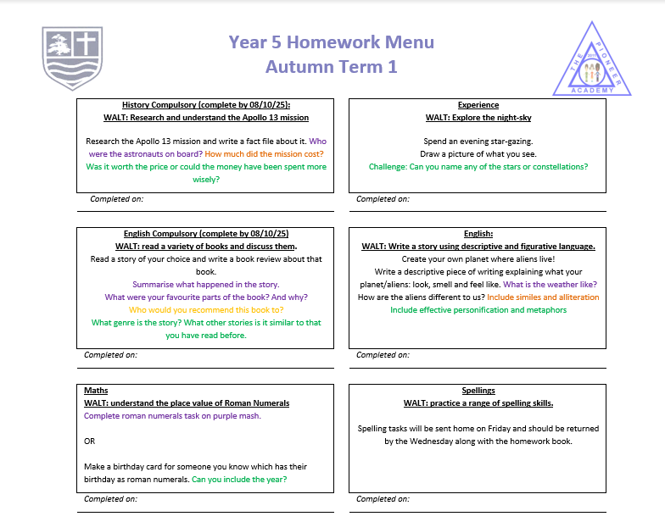
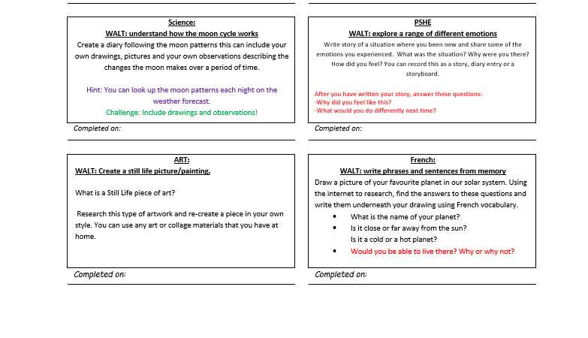
Homework

Slide 16
P.E. days
Wright- Wednesday & Friday
Hepworth- Monday & Friday
Mercury- Monday & Friday

Slide 17
Parental Engagement
Trip:
Science Museum- 24th September 2025 – the trip relies on your generous support, so please do let us know if you are able to accompany us.
Dates to be aware of:
individual and sibling photos – 8th October 2025
Parent’s evening – 14^{th & 15th} October 2025
KS2 Reading morning – 16th October 2025
Although a while away, the Year 5 residential is Wednesday 15th April- Friday 17th April. Correspondence around this will follow in the next week.
All events can be found on the parent calendar.

Slide 18
Questions?

