Slide 1


Good Morning!
Welcome to Year 4 Curriculum Meeting

Slide 2
Year 4 Team
Curie Class: Ms King and Mrs Flint-Virtue
Bowie Class: Ms Grover
Mercury Class: Mr Smith
Teaching assistants: Mrs Mcllroy, Mrs Laferla
Specialist Teachers
Mr Williams – PE
Mrs Howe – Art / DT
Mrs Edmunds – Music
Mr Robbins - Computing

Slide 3
School Vision
Every day at Stewart Fleming is an extraordinary school day. Our unwavering commitment in delivering an inspiring and inclusive curriculum develops independent learners. We endeavour to nurture inquisitive minds to enable them to become the best that they can be.

Slide 4
Soft Start Morning 8:45 – 9:00
At Stewart Fleming we believe that in order to expect positive and respectful communication, we need to model and provide opportunities for it within our school day. Therefore, we encourage all children to come to for at 8:45 am start.
Once the children enter their classroom there will be music playing, books to read, partner games to play and optional curriculum or tasks to do.
The tasks may cover aspects of our SMSC (spiritual, moral, social and cultural development) calendar such as Road Safety Week, Anti-Bullying Week and Children in Need.
Teachers and support staff in the room play a crucial role. They engage with children, support children's excitement of learning for the day and tutor. This morning routine is fundamental to driving Stewart Flemings ethos as it develops independence, positive communication and well-being of every child.

Slide 5
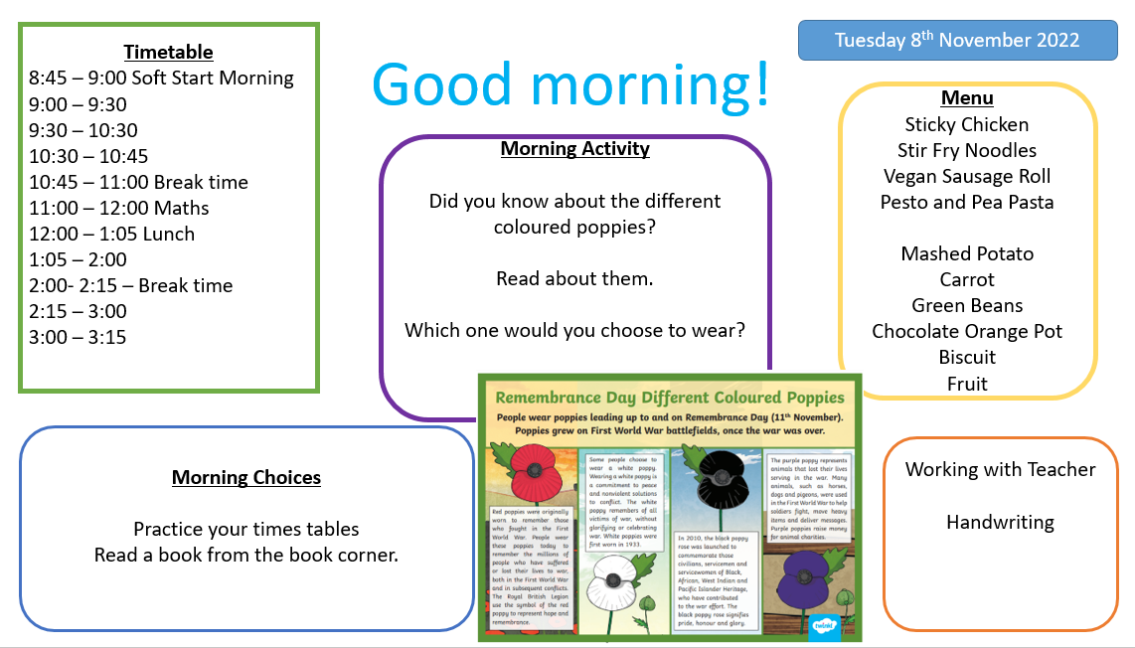

Slide 6

Curriculum Offer at Stewart Fleming
Subject | Curriculum Scheme
English (Reading) | Little Wandle (EYFS – Y2) CUSP
English (Writing) | CUSP
Maths | White Rose Maths
Science, History, Geography, DT and Art | IPC (International Primary Curriculum)
French | Language Angels
Computing | IPC
PE | PE PRO
RE | Bexley Scheme
PSHE | IPC and CWP

Slide 7
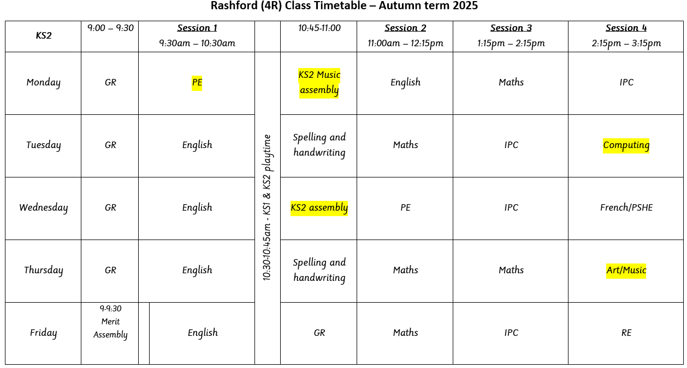
French/PSHE and Art/Music will swap with each other every week.
One week the children will have French and Art and then the next they will have PSHE and Music.
Please see the curriculum letter for your child’s PE days.
PE Days
Rashford – Monday and Wednesday
Bowie –
Curie – Tuesday and Thursday

Slide 8



English
In English, we will be following a scheme of work called CUSP. This will embed literary skills into Reading, Writing and Spelling.
In our guided reading lessons this half term we will start by looking at the story The Queen’s Nose. In the second half of the autumn term, we will move on to study The Girl who Stole an Elephant. Throughout the year, will be looking at a range of texts to expose children to a breadth of authors, formats and styles.
In our English lessons, we will be teaching the children skills that will enable them to identify the features of, and independently write poems and create persuasive adverts.

Slide 9
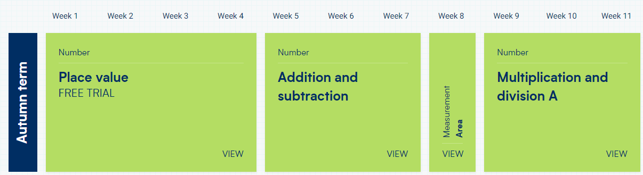
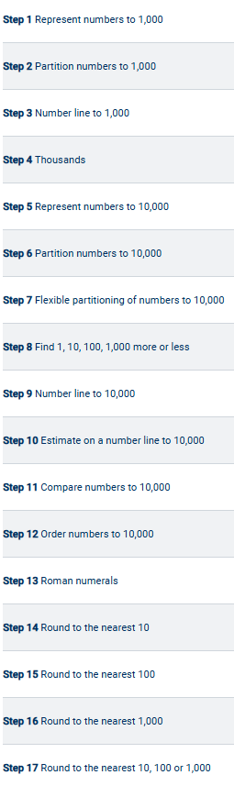
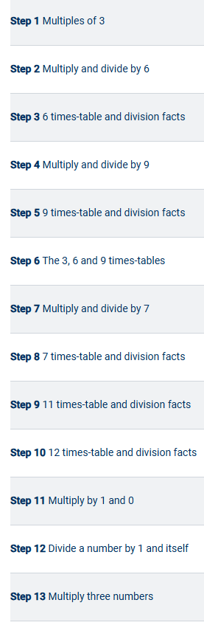
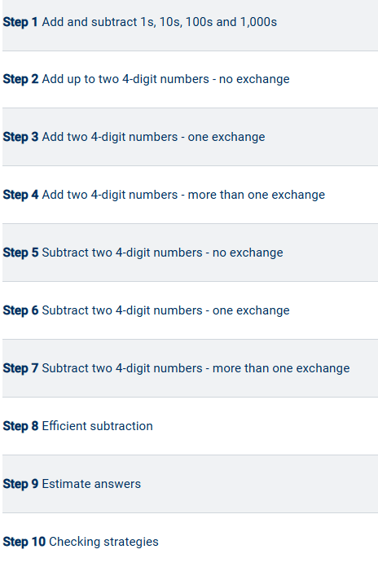
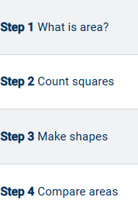
Maths
In Maths, we will be starting by looking at Place Value before moving on to Addition and Subtraction.
We will then move on to Multiplication and Division.
Every lesson will develop children’s fluency and reasoning as well as their problem-solving skills.

Slide 10
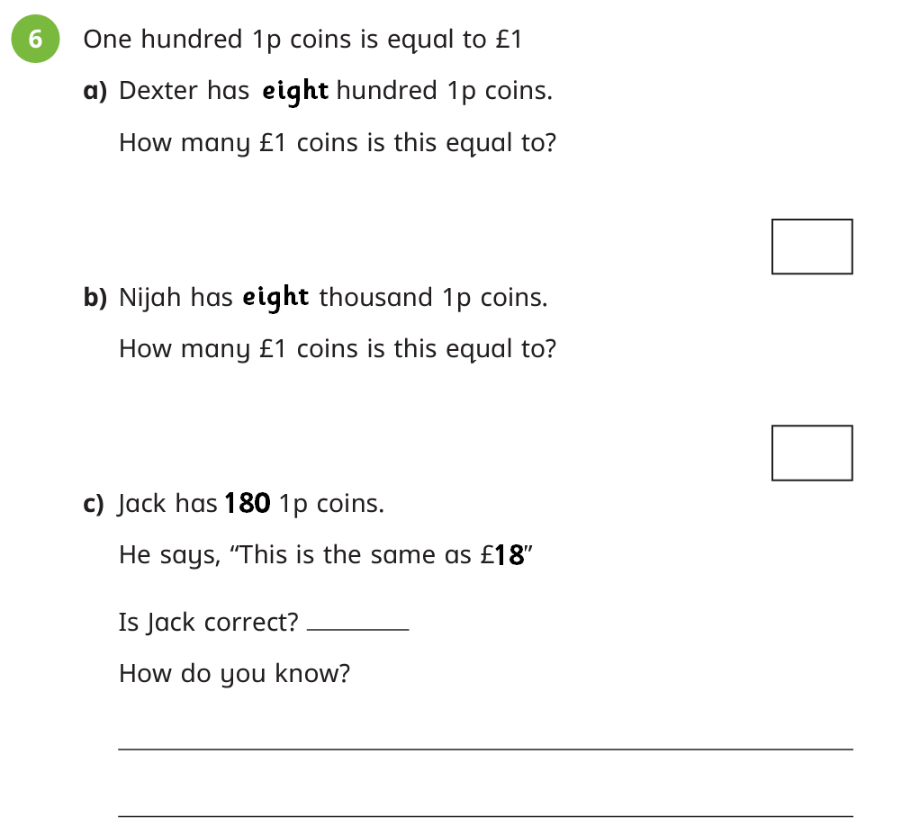
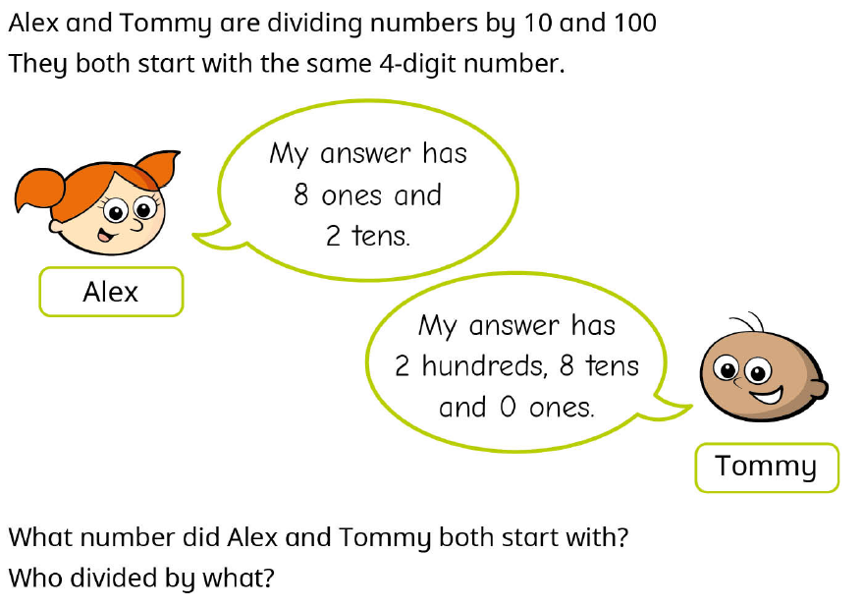
Maths
Every lesson, children are exposed to reasoning and problem solving.
These challenge questions are designed to make the children explain their reasoning, often requiring them to explain how they got to their answer.
Sometimes, these can have multiple answers which helps to develops the children’s thinking skills.

Slide 11

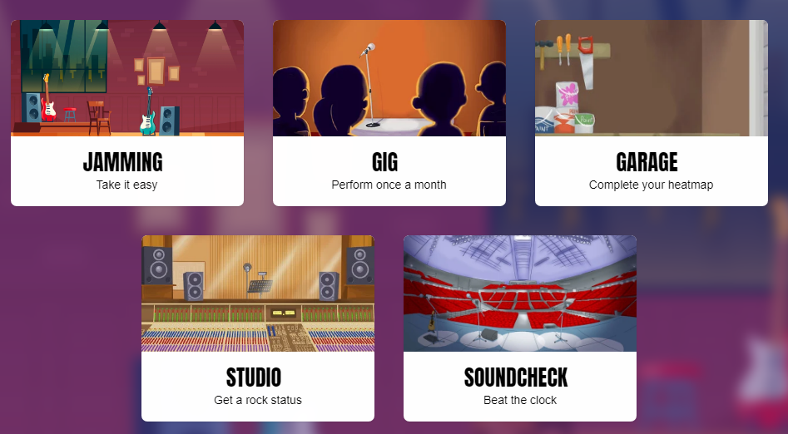
Maths
This year, the children will be taking part in an MTC (Multiplication Tables Check).
There are 25 questions in total, with 6 seconds to answer each question.
You can support your child’s multiplication knowledge by logging into Times Table Rockstars and completing at least 3 Soundchecks a week at home.

Slide 12
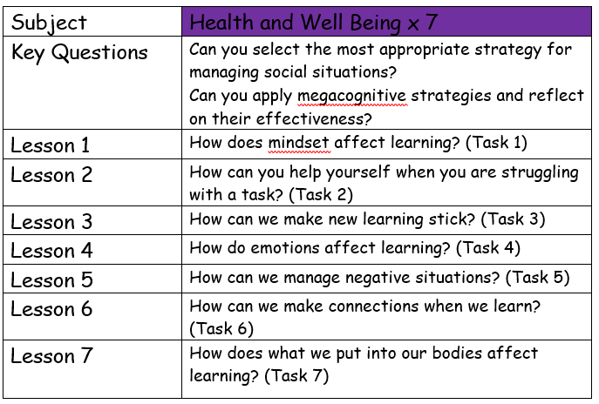
IPC Topic: Brainwave
This is a 3 week topic that is PSHE focused.
It will help children consider how they learn and how their brains work.

Slide 13
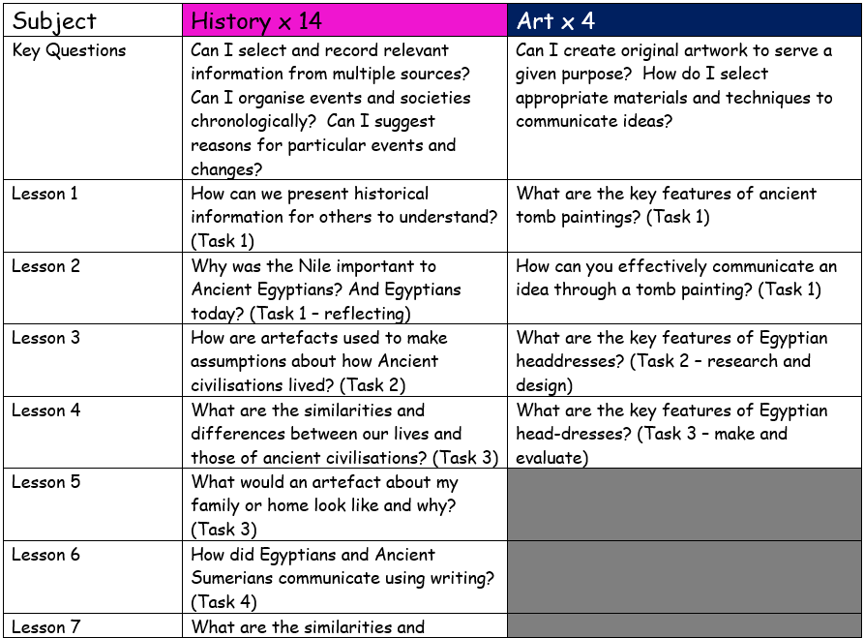
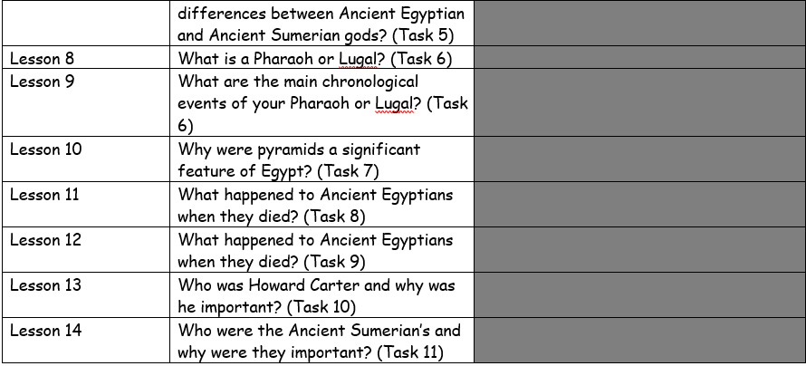
IPC Topic: Temples, Treasures and Tombs
This is a 6 week topic that is History focused and will span over Autumn 1 and Autumn 2.
We will be learning all about Ancient Egypt and Ancient Sumer and comparing the two.

Slide 14
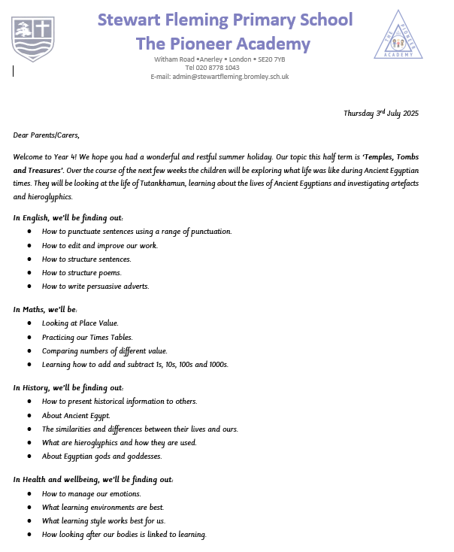
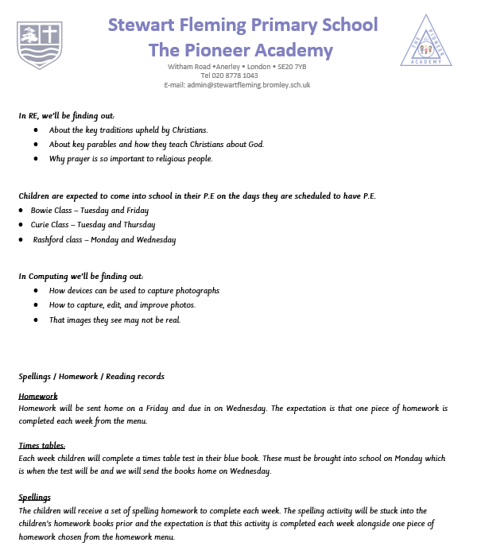
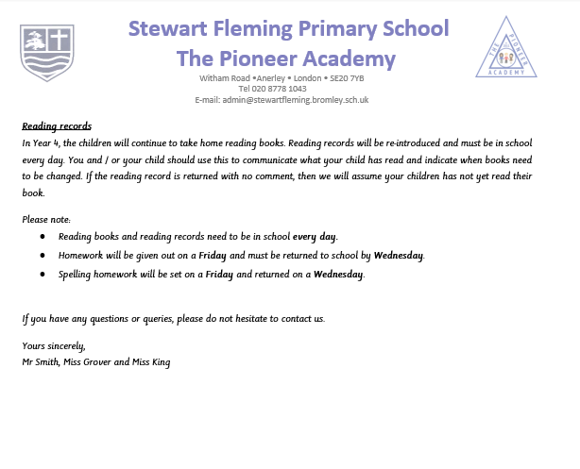
Curriculum Letter

Slide 15
Homework
A homework menu will be sent home for this half term. It has already been stuck into your child’s homework book. We ask that children complete at least one piece of homework every week and that they hand in their homework books on Wednesdays.
We do also ask that children read at least 3 times a week at home. This can be reading a match report or a newspaper article, not just the book that they have taken home! Please do remind your children to document their reading.
Children will also take part in weekly times tables tests in school and record these in their Times Table books. Please support your child to practise their times tables every week. You could document your times tables practise by writing in your blue times table book, or by practising on times table rockstars.

Slide 16
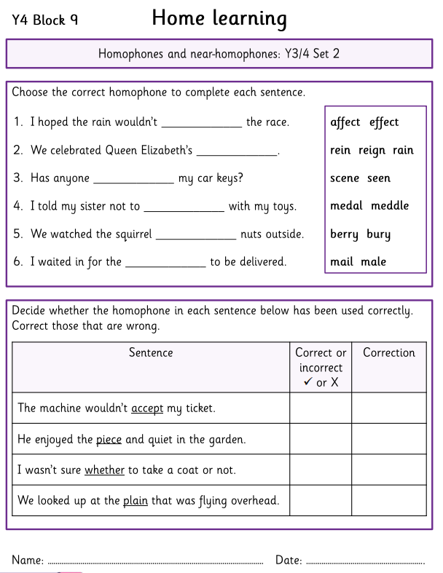
Spelling homework
Spelling homework will continue to be handed out in on a Friday to be completed by the Wednesday.
Spelling rules and patterns are taught through discrete spelling lessons.
This is in addition to the homework menu. There is no longer a weekly spelling test.

Slide 17
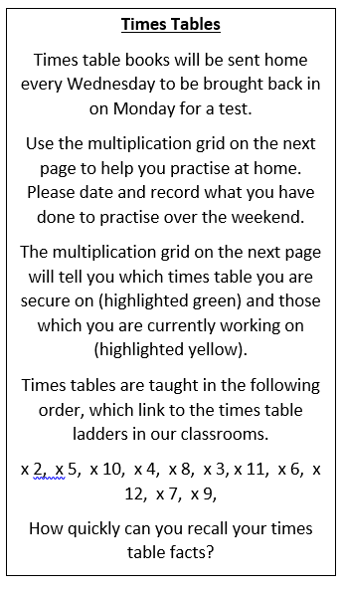
Times tables
Each week, the children will be take home their times table book (a small blue book). You can use this book at home with your child to practise their timetables. You can record your timetable practise in the blue book if you would like to.
At the beginning of the week, the children will have a short times tables test at the beginning of their maths lesson. The timetable test will be stuck in to their small blue book.
Practice does not need to be done in books, it could be completed on TTRS.

Slide 18
Parental Engagement
This half term, each class will be going swimming every afternoon for 2 weeks at South Norwood Leisure Centre from the W/C 22nd September until the end of half term.
The swimming lessons will take place from either1-2pm or 2-3pm. If your child’s class’s swimming is from1-2pm, they will be having an early lunch and leaving school after lunch.
Each class will need parent volunteers for this trip to go ahead. Please let your child’s Class Teacher know if you are available on any of the days to help.
There will also be other opportunities to support your child’s class throughout the year.
More information regarding swimming lessons will follow via a letter soon.

Slide 19
Questions?
If you have any general questions we would be happy to answer some now.
You can also always speak to your child’s class teacher at the door in the morning and in the afternoon to pass on short messages. You can also email or telephone the school office to arrange to speak with your child’s class teacher.

