Slide 1


Good Morning!
Welcome to Year 3 Curriculum Meeting

Slide 2
Year 3 Team
Class Teachers
Singh Class – Miss Scott
Boyega Class – Miss Oliveira
Kahlo Class – Mr Martin
Specialist Teachers
Mr Williams – PE
Ms Howe – Art / DT
Miss Edmunds –Music
Support Staff
Mrs Laferla
Mrs Urquhart
Miss Allen

Slide 3
School Vision
Every day at Stewart Fleming is an extraordinary school day. Our unwavering commitment in delivering an inspiring and inclusive curriculum develops independent learners. We endeavour to nurture inquisitive minds to enable them to become the best that they can be.

Slide 4
Soft Start Morning 8:45 – 9:00
At Stewart Fleming we believe that in order to expect positive and respectful communication, we need to model and provide opportunities for it within our school day. Therefore we encourage all children to come to for at 8:45 am start.
Once they come into their room there will be music playing, books to read, partner games to play and optional curriculum or PSHE tasks to do.
The tasks cover aspects of our SMSC (spiritual, moral, social and cultural development) calendar such as Road Safety Week, Anti-Bullying Week and Children in Need.
Teachers and support staff in the room play a crucial role. They engage with children, support children's excitement of learning for the day and tutor. This morning routine is fundamental to driving Stewart Flemings ethos as it develops independence, positive communication and well-being of every child

Slide 5
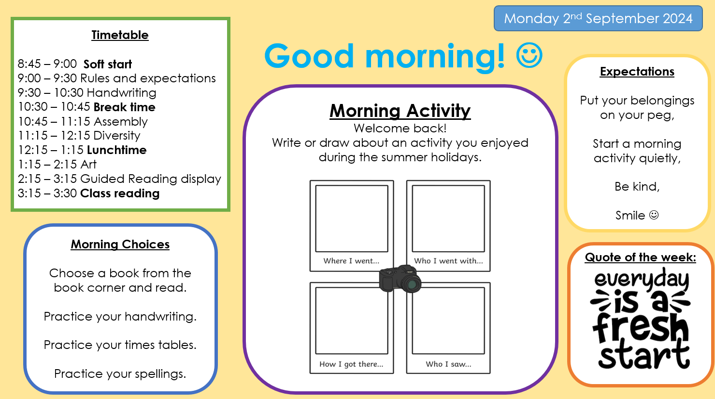

Slide 6

Curriculum Offer at Stewart Fleming
Subject | Curriculum Scheme
English (Reading) | Little Wandle (EYFS – Y2) CUSP
English (Writing) | CUSP
Maths | White Rose Maths
Science, History, Geography, DT and Art | IPC
French | Language Angels
Computing | IPC
PE | PE PRO
RE | Bexley Scheme
PSHE | IPC and CWP

Slide 7
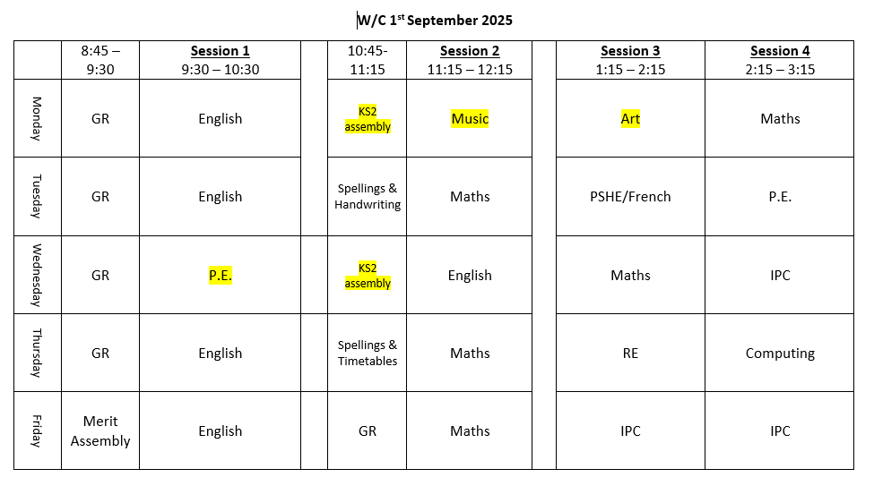
Timetable
Boyega Class
- Healthy snacks for AM playtime
Movement/brain breaks in the afternoon.
P.E. days

Slide 8



English
For Reading and English, we will have 5 CUSP lessons per week.
Each morning we complete our reading lesson for 30 minutes (9-9:30), followed by our 1 hour English lesson.

Slide 9
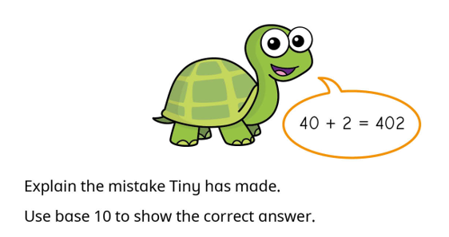
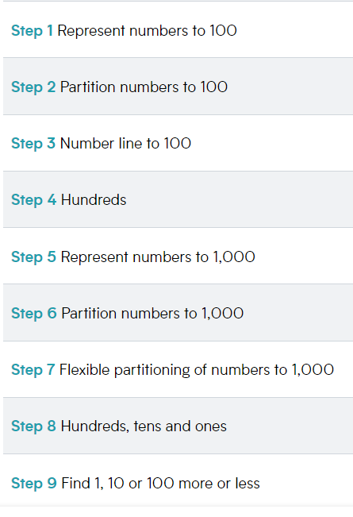
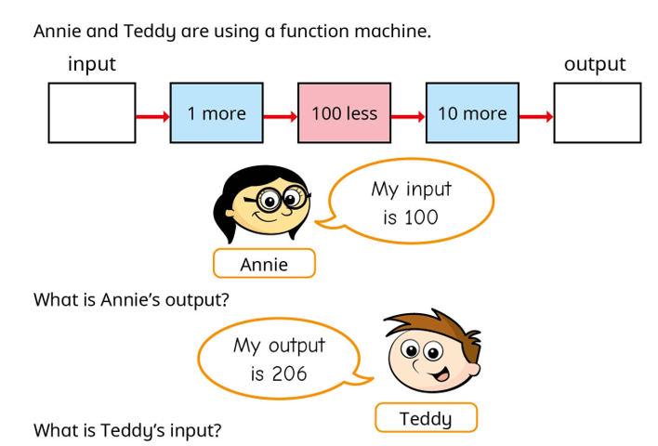
Maths
Every lesson, children are exposed to reasoning and problem solving.
These challenge questions are designed to make the children explain their reasoning, often requiring them to explain how they got to their answer.

Slide 10
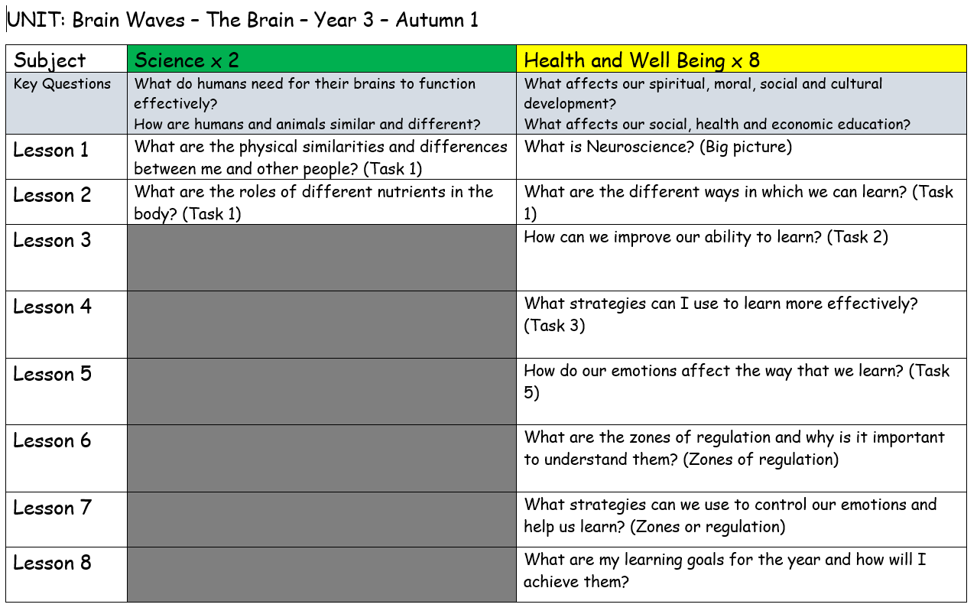
IPC Topic: Brain Waves
This topic covers both Science and Health and Well Being lessons for this half term:

Slide 11
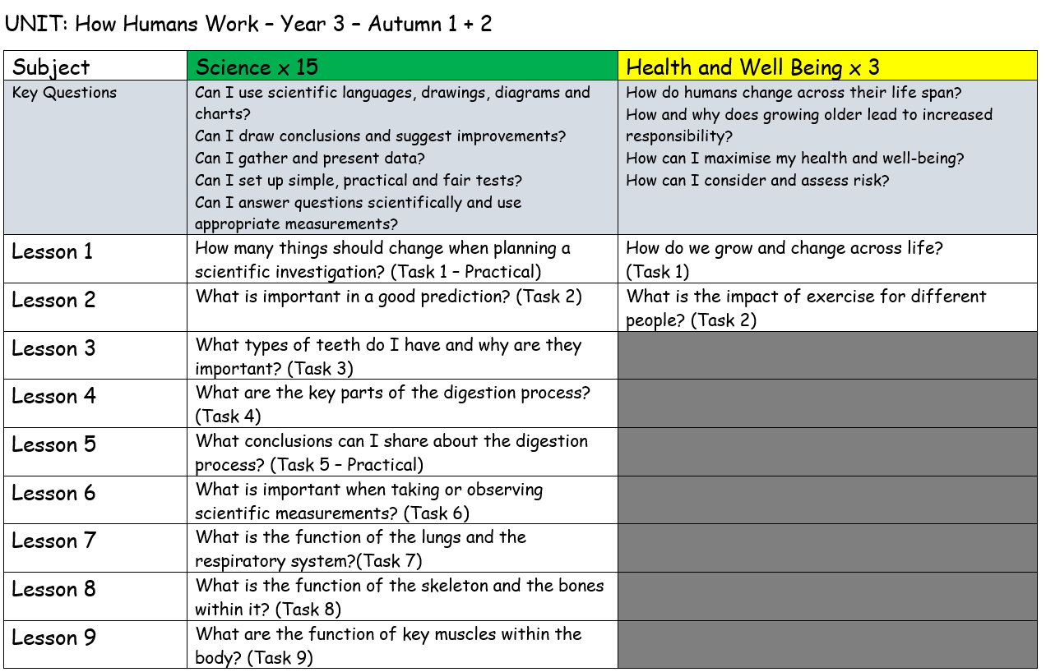
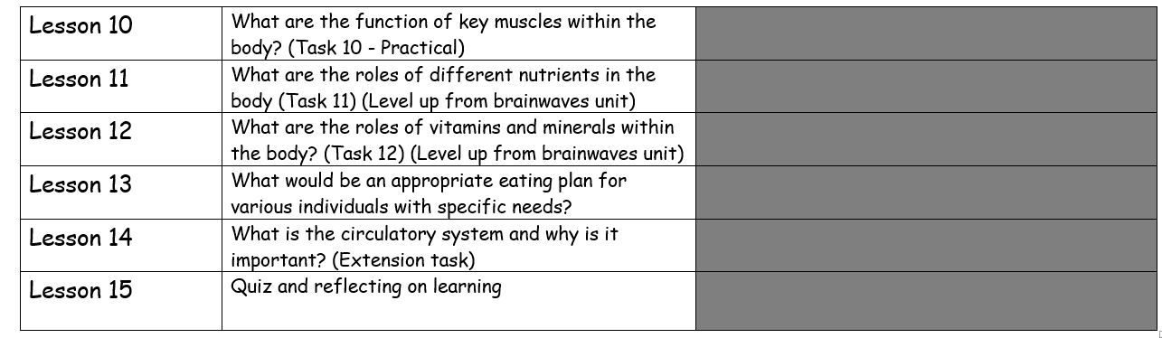
IPC Topic: How Humans Work
This topic covers both Science and Health and Well Being lessons for the half term:

Slide 12
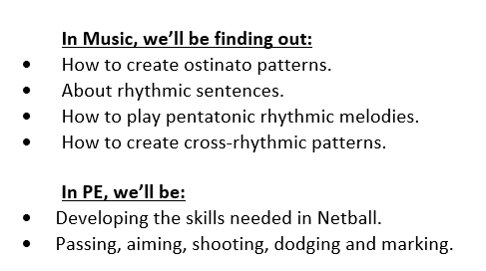
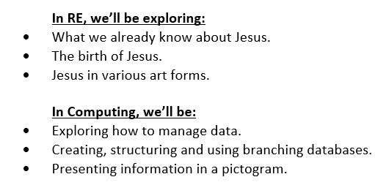
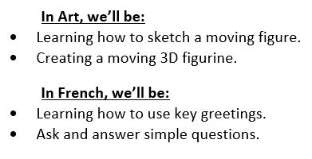
Curriculum Letter

Slide 13
Homework
Homework - home on Friday, bring back in on Wednesdays
Spelling Books
Reading Records
Times Tables Books – home on Friday, bring back in on Wednesdays

Slide 14
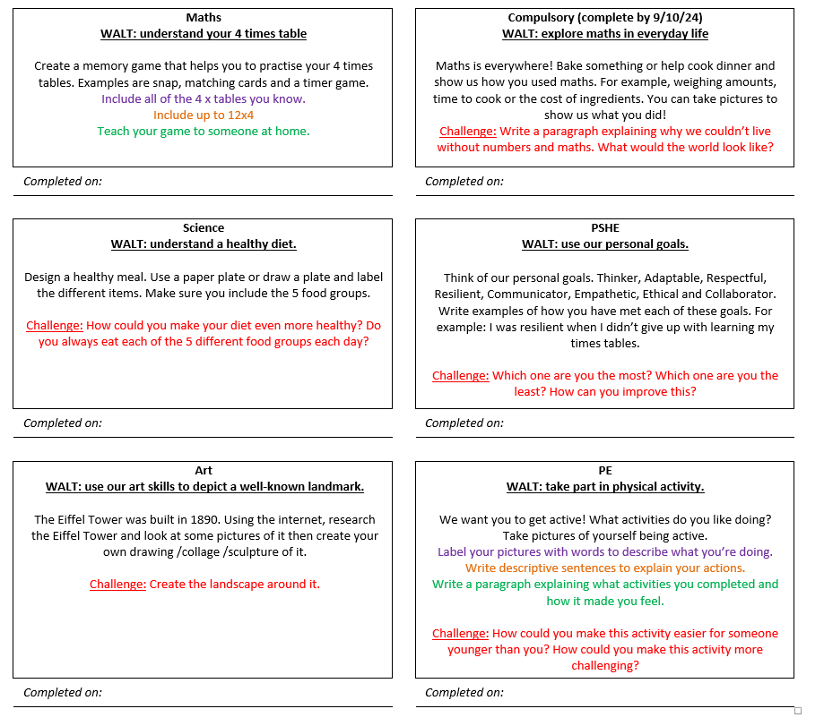
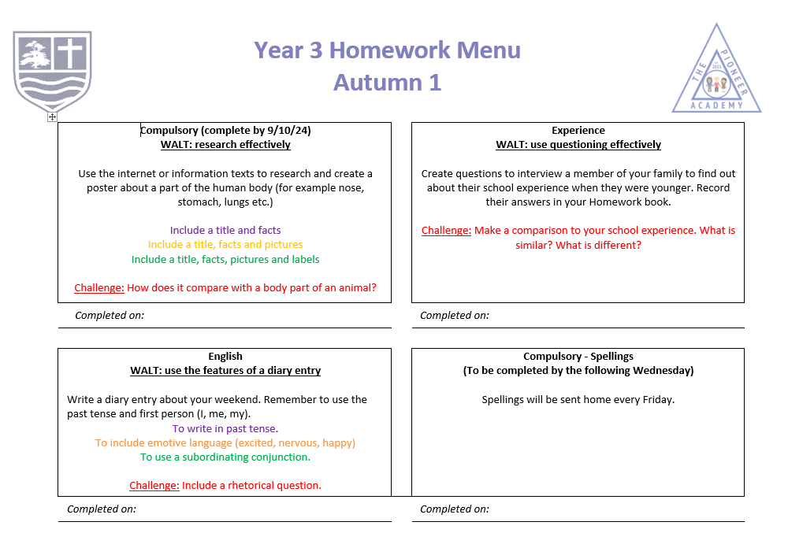
Homework

Slide 15
Parental Engagement
Class trip to the Science Museum to take part in the workshop
‘It Takes Guts!’ – relating to ‘How Humans Work’
Thursday 9th October for all classes
Please speak to your class teacher if you would like to volunteer to come with us!

Slide 16
Questions?

