Slide 1


Good Afternoon! Welcome to the Year 6 Curriculum Meeting

Slide 2
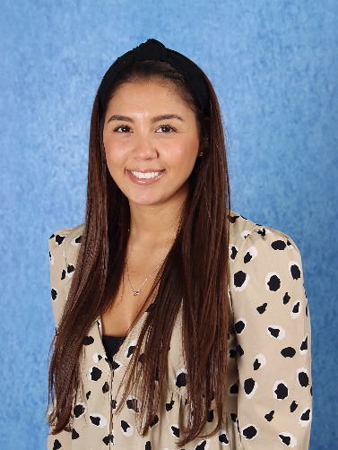
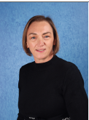
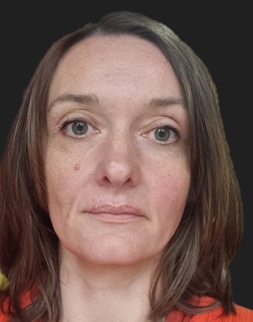
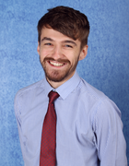
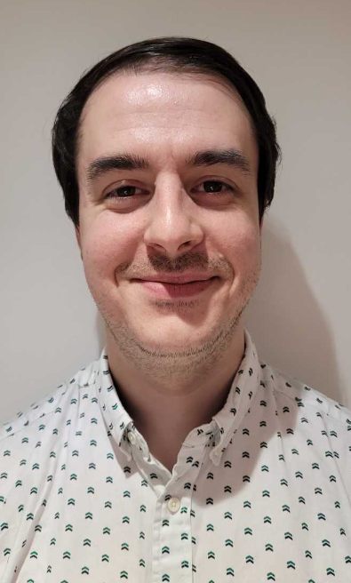
Year 6 Team
Class teachers
Miss Haynes
Mr Bushnell-Ewers
Mr Robbins
Miss Pearce
Mrs Yurick
Specialist Teachers
Jordan Williams – PE
Lindsay Howe – Art / DT
Angharad Edmunds –Music
Mr Robbins- Computing

Slide 3
School Vision
Every Day at Stewart Fleming is an extraordinary school day. Our unwavering commitment in delivering an inspiring and inclusive curriculum develops independent learners. We endeavour to nurture inquisitive minds to enable them to become the best that they can be.

Slide 4
Soft Start Morning 8:45 – 9:00
At Stewart Fleming we believe that in order to expect positive and respectful communication, we need to model and provide opportunities for it within our school day. Therefore we encourage all children to come to for at 8:45 am start.
Once they come into their room there will be music playing, books to read, partner games to play and optional curriculum or PSHE tasks to do.
The tasks cover aspects of our SMSC (spiritual, moral, social and cultural development) calendar such as Road Safety Week, Anti-Bullying Week and Children in Need.
Teachers and support staff in the room play a crucial role. They engage with children, support children's excitement of learning for the day and tutor. This morning routine is fundamental to driving Stewart Flemings ethos as it develops independence, positive communication and well-being of every child

Slide 5
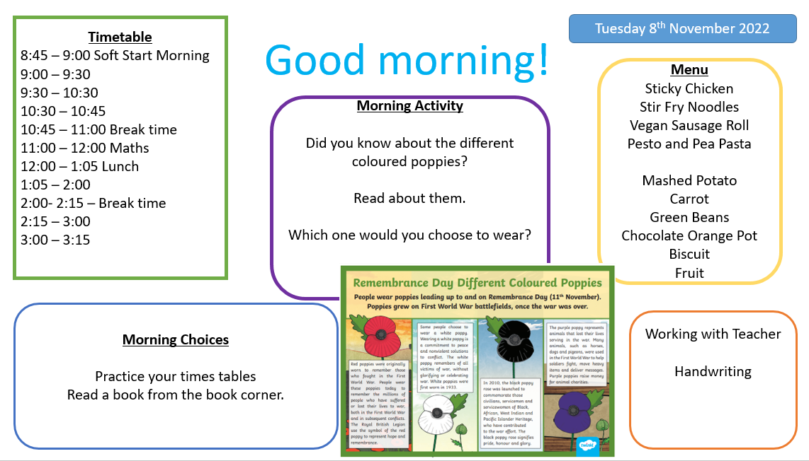

Slide 6

Curriculum Offer at Stewart Fleming
Subject | Curriculum Scheme
English (Reading) | Little Wandle (EYFS – Y2) Whole class Guided Reading using CUSP
English (Writing) | Power of Reading
Maths | White Rose Maths
Science, History, Geography, DT and Art | IPC
French | Language Angels
Computing | IPC
PE | PE PRO
RE | Bexley Scheme
PSHE | IPC and CWP

Slide 7
Congratulations!
Mr Bushnell-Ewers is officially on paternity leave following the birth of his new son!
His guided reading groups and afternoon lessons in his home class will be covered by Miss Pearce and Mr Leggatt will be covering his English and Maths groups until he returns.
If you have any queries or require support, please contact Miss Haynes.

Slide 8
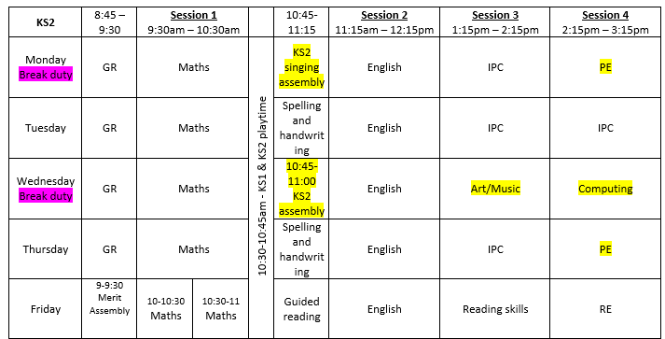
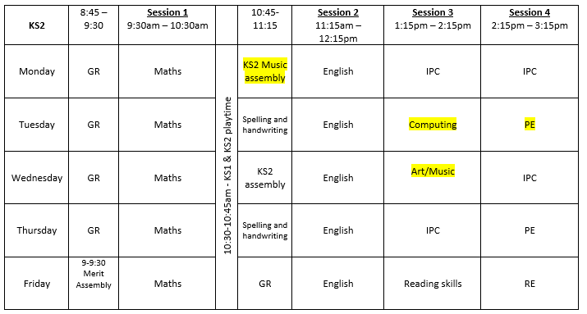
Timetable
Turing
Zephanaiah
Music and art on alternating weeks
PSHE and French to be taught as blocks during the Summer Term

Slide 9


English
Revising key writing skills: Vocabulary, conjunctions, openers and punctuation
Exploring Shakespeare’s sonnets and comparing them with a range of poetry from periods in the past
Writing adventure stories from a third person perspective
Considering how to balance dialogue and description in order to move a story forward

Slide 10
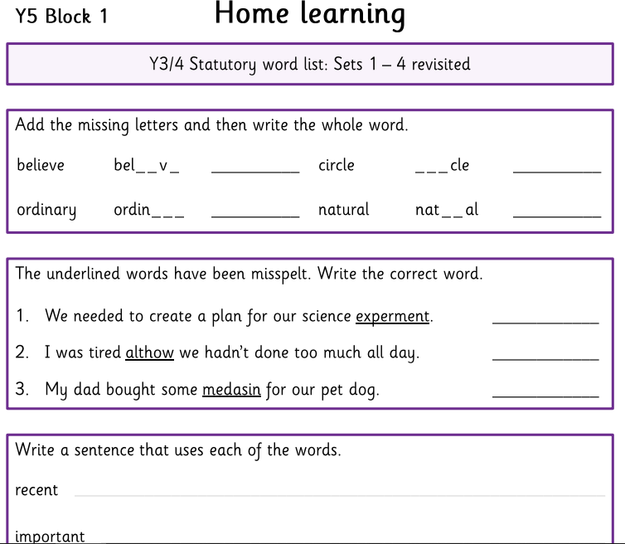
Reading and spellings
Children are still expected to read and comment 3x per week.
Comments should be written by the child or adult and focus on things that they have enjoyed, struggled with, summaries and predictions. We love to see a range of texts being explored.
Spellings will now be weekly and tasks will be stuck into homework books. See example.
When completing spellings homework, we do encourage children to use a physical dictionary if they are unsure how to spell a word. If they don’t have access to a dictionary, online dictionaries can also be used to support them.

Slide 11
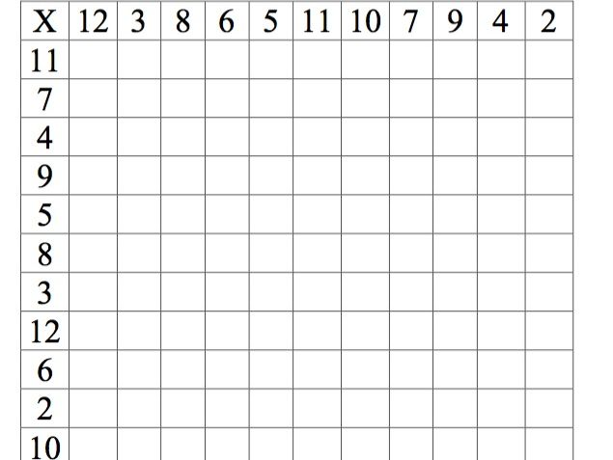
Times tables
Times tables will be tested weekly.
We will not be sending books home but we encourage children to practice on TTRS ready for a test on a Monday!
In Year 6, many children will be on Mixed practice. However, if children are focusing on one set, this will be shared. They will move on after 3 consecutive weeks of successful application.

Slide 12
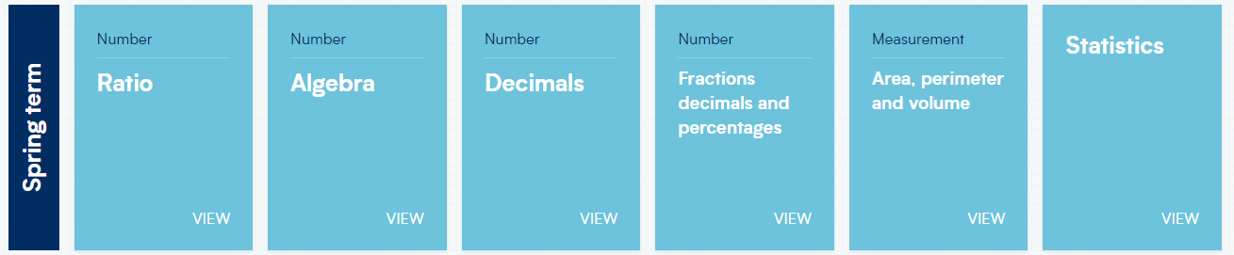
Maths
Times tables underpin various areas of our maths curriculum therefore even if your child is fluent, we do encourage them to practice regularly.

Slide 13
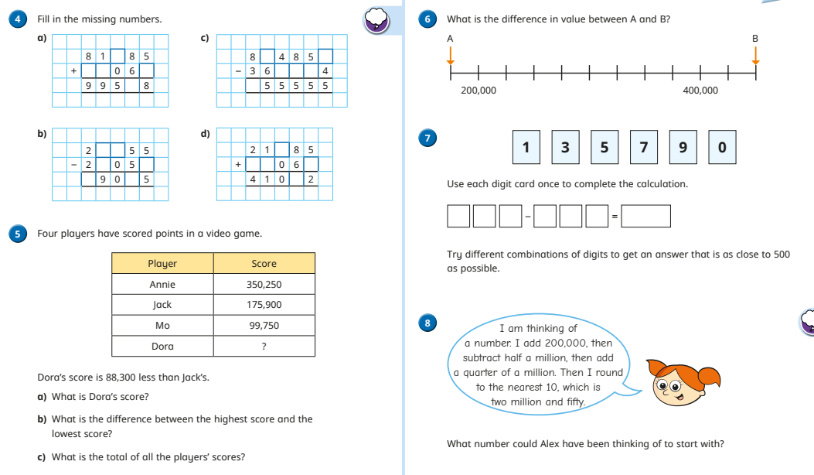
Maths
Every lesson children are exposed to fluency and reasoning questions.

Slide 14
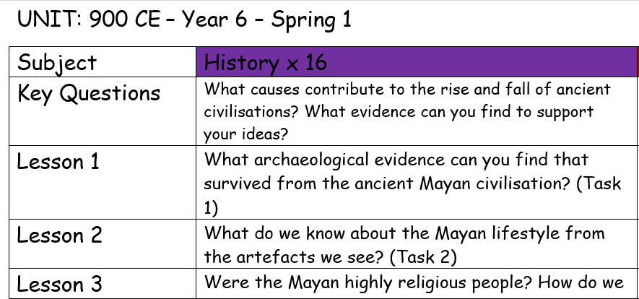
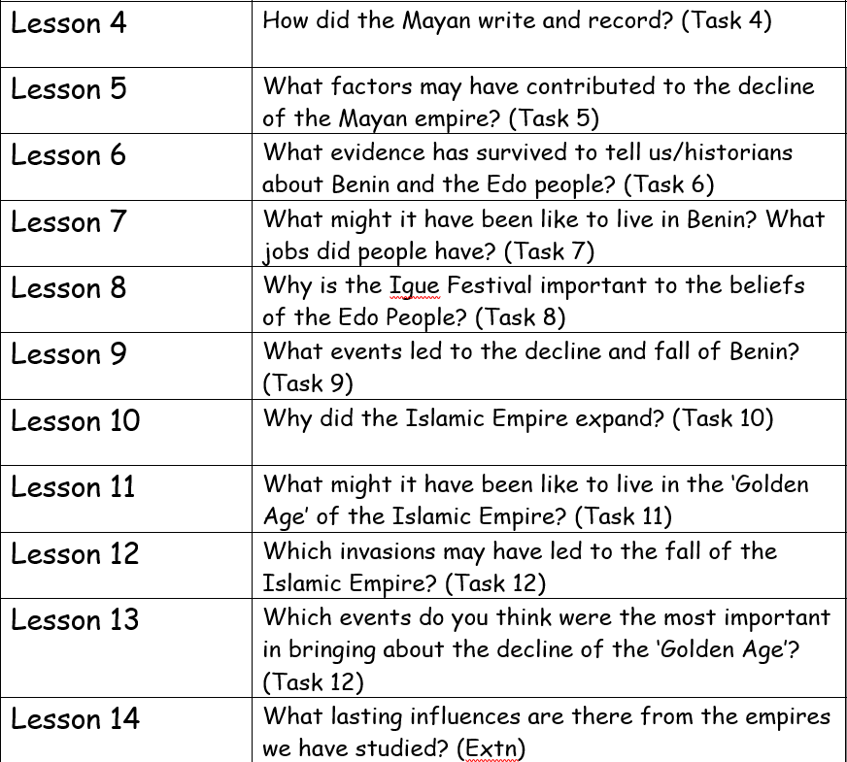
IPC Topic:900CE
This topic covers History for this half term:

Slide 15
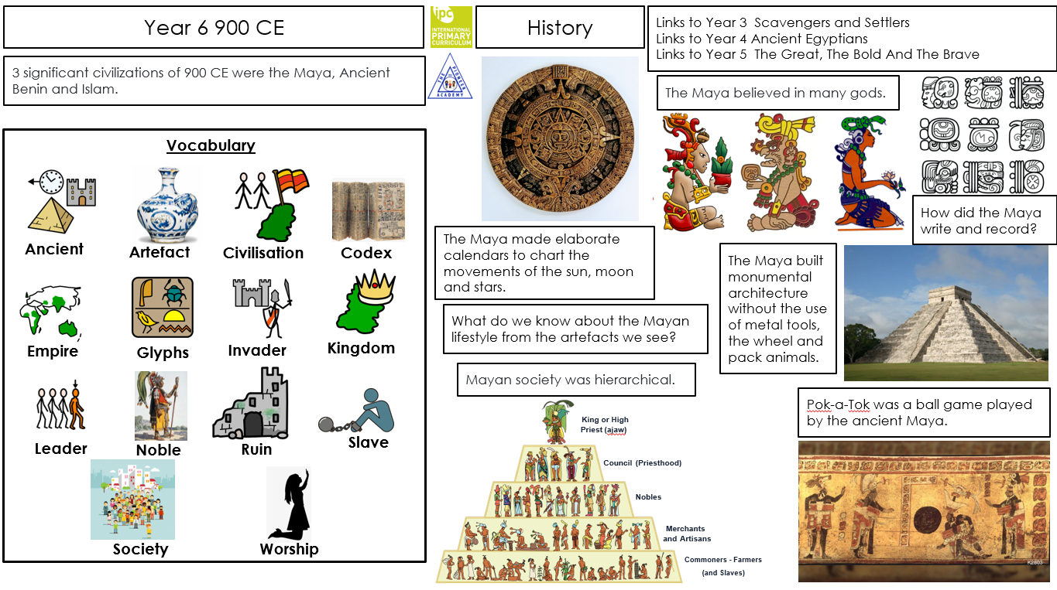

Slide 16
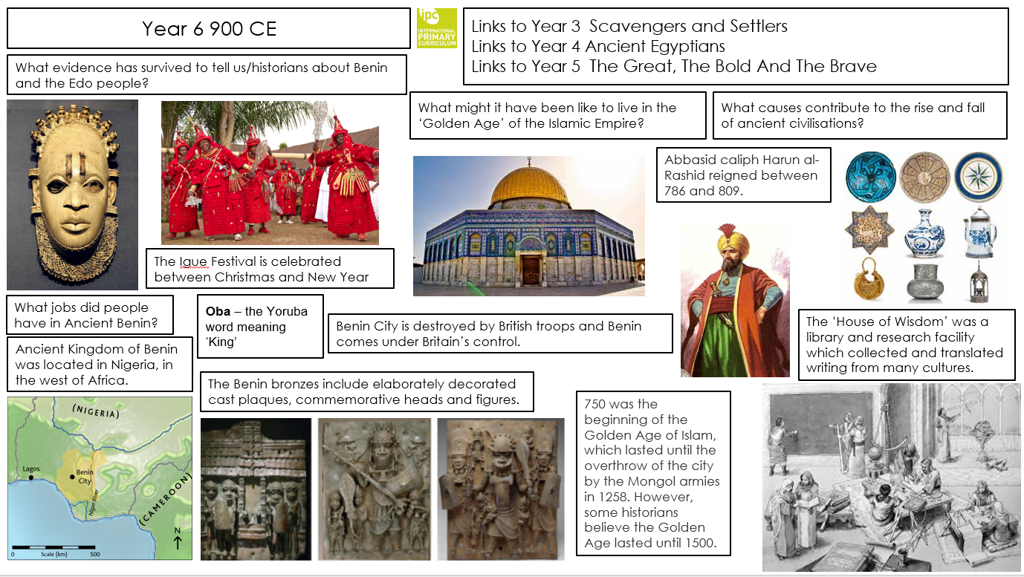

Slide 17
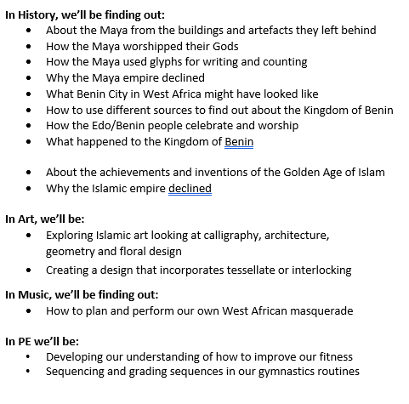
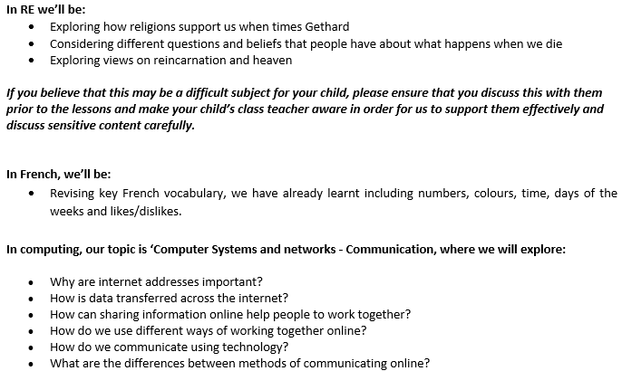
Curriculum Letter

Slide 18
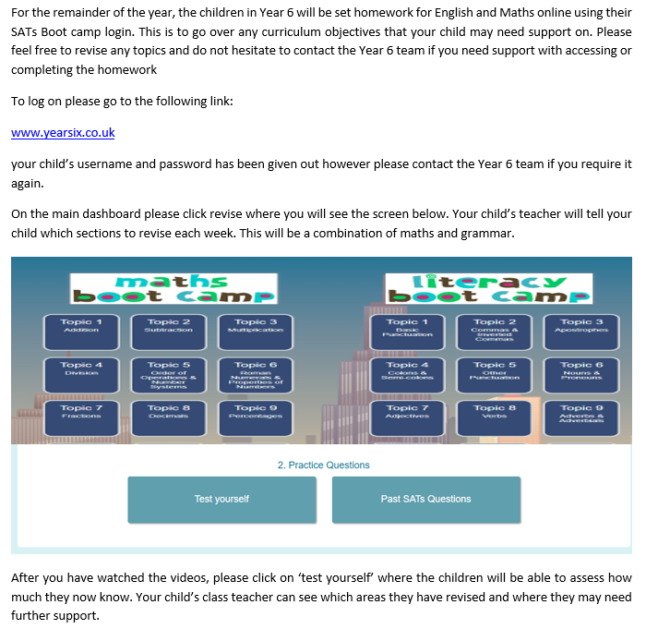
Homework

Slide 19
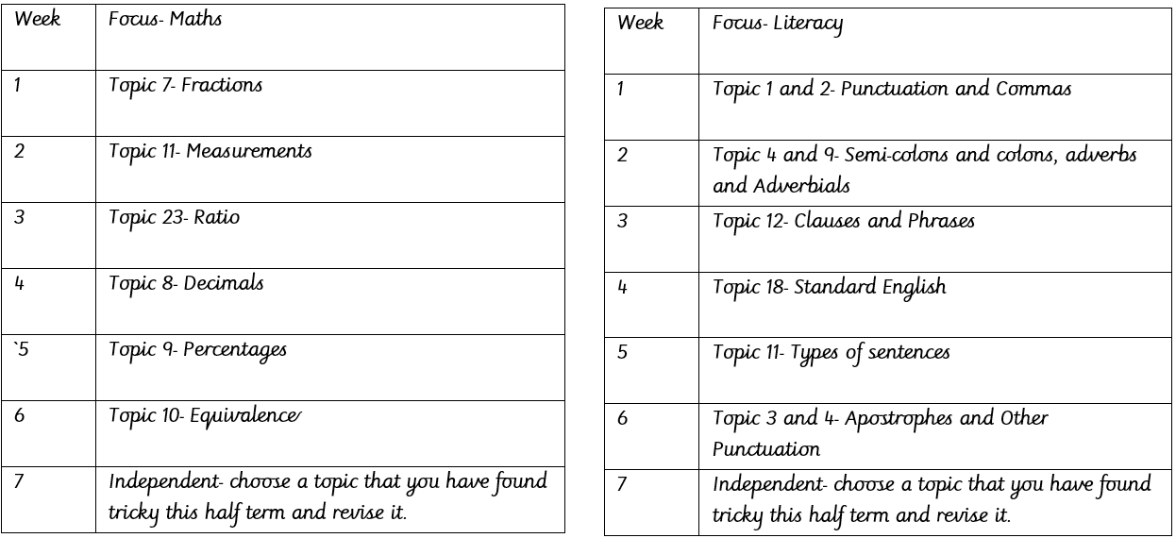
SATs Boot Camp
Your child will receive a log in for SATs Boot Camp- they can access past papers and questions alongside revision videos for each strand of the curriculum in maths and grammar.

Slide 20
Boosters
Mr Bushnell-Ewers’ booster will not be running until the week beginning 19th January. His booster after school will now run on a Thursday.
Miss Pearce’s booster will also start back up on the week beginning 19th January.
Miss Haynes booster will start as normal on Monday.
Email communications
We have been made aware that many parents and carers have missed emails from the school recently.
Unfortunately we cannot rectify this as you must add the parentpay email address to safe sender list
To add emails to a safe sender list, you typically add the sender to your contacts or create a filter in your email settings to mark them as "Not Spam" or "Never Block" and ensure they go to your inbox, preventing them from being caught by spam filters.

Slide 21
Parental Engagement
KS2 SATs:
Week beginning 14th May 2026
Key dates:
Year 6 Art Trip- 26th January
Year 6 Trip to the Globe Theatre- 26th February
World Book Day- 5th March
Parent’s evenings- 3rd and 4th March
There will be a separate forum for SATs and the residential in due course
Please express interest if you would like to volunteer! If we do not have enough volunteers, the trips cannot take place.

Slide 22
Questions?
Thank you for attending this meeting. We appreciate all your support.

